Slide 1
Guided Visual Analytics for Image Selection in Time and Space
Ignacio Pérez-Messina
Davide Ceneda
Silvia Miksch
Institute of Visual Computing and Human-Centered Technology
TU Wien
Notes:
Hi, I am Ignacio Pérez-Messina, predoc researcher at TU Wien, and I’ll present Guided Visual Analytics for Image Selection in Time and Space, on behalf of my coauthors Davide Ceneda and Silvia Miksch.

Slide 2
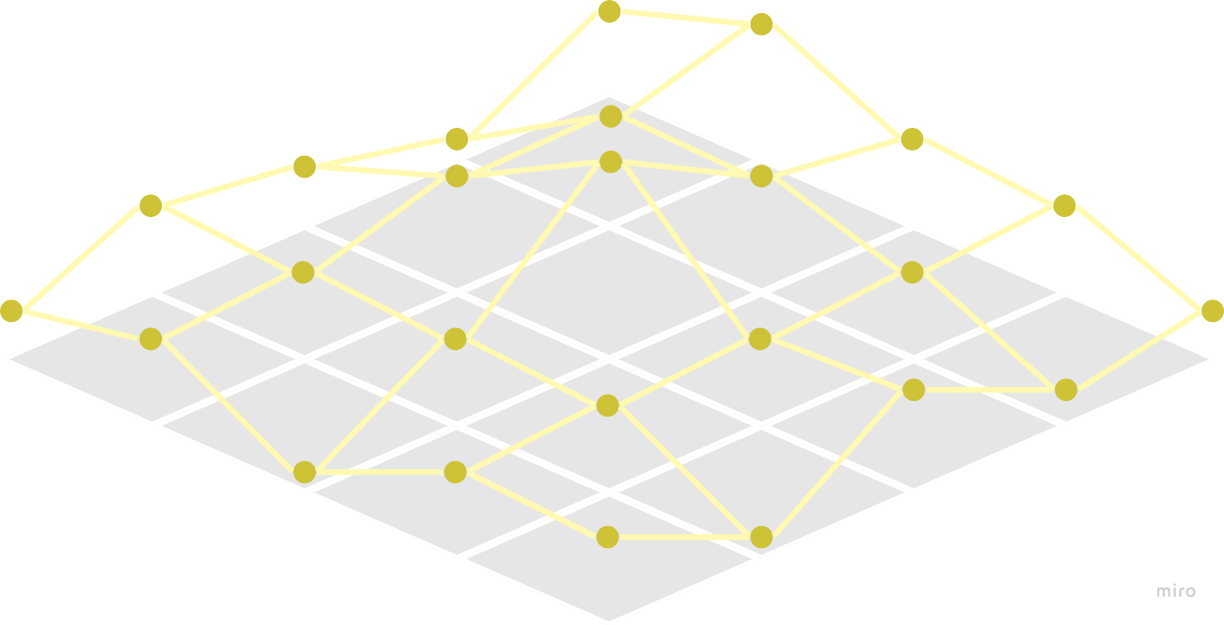
EXPERT SYSTEM
HUMAN EXPERT
SOLUTION SPACE
Notes:
In this paper, we tackle an interactive optimization problem from the perspective of guided visual analytics. In interactive optimization, a very big solution space is explored collaboratively by human and system.

Slide 3
GUIDANCE
EXPERT SYSTEM
HUMAN EXPERT
SOLUTION SPACE
GUIDANCE
Notes:
They way the system communicates its results to the user, we call guidance.

Slide 4
Guidance degrees
Enact a full solution to the the task
most constraining
Prescribing
ORIENTING
Provide a ranked list of options
Directing
EXPERT SYSTEM
Orienting
least constraining
DIRECTING
PRESCRIBING
Enhancing the user’s mental map
SYSTEM GUIDANCE
Ceneda, D., Gschwandtner, T., May, T., Miksch, S., Schulz, H. J., Streit, M., & Tominski, C. (2016). Characterizing guidance in visual analytics. IEEE transactions on visualization and computer graphics, 23(1), 111-120.
Notes:
There are three degrees in which the system provides guidance to the user, going from less imposing, less constraining, on user freedom, to more constraining. The degrees, from the lowest to the highest are; orienting, which is providing a sense of what how the model sees the problem; directing, providing a set of options to take; and prescribing, which is providing one full course of action.

Slide 5
UXO Detection from Aerial Images
Notes:
We applied guidance to the task of UXO Detection from Aerial Images, which I’ll introduce now.

Slide 6
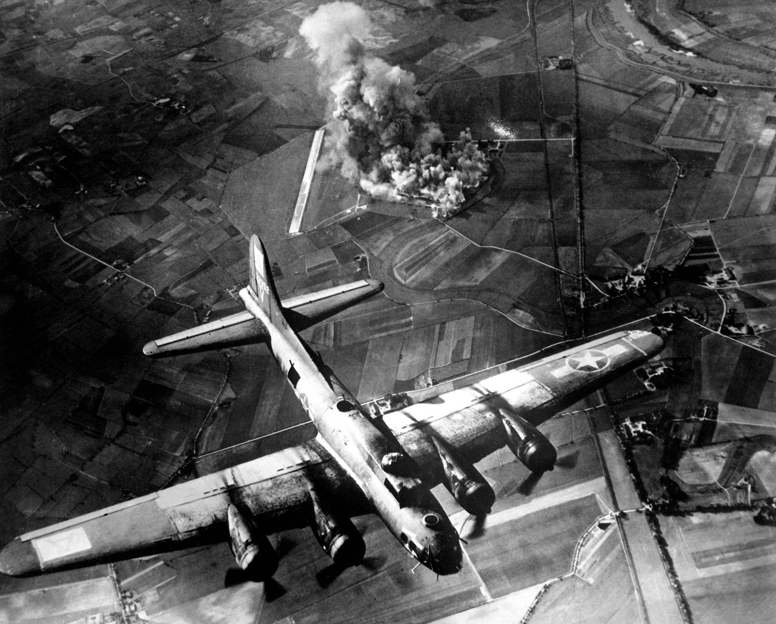
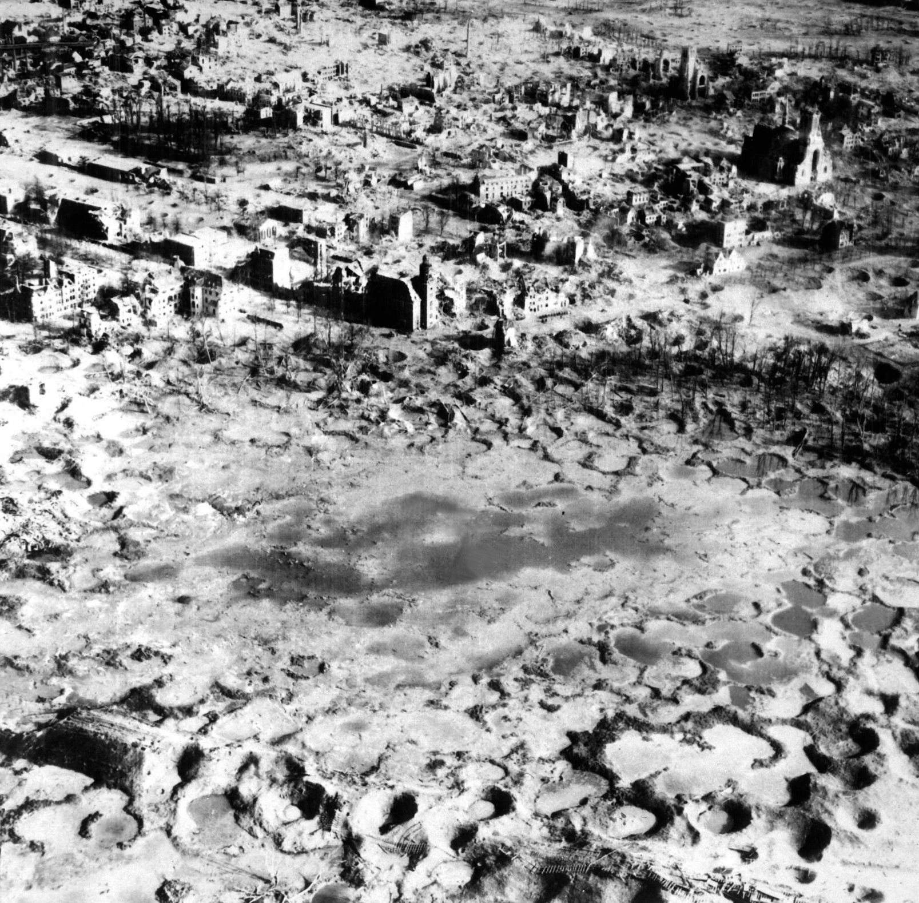
Notes:
During World War II millions of tons of bombs were dropped in aerial bombings. These bombings left a lasting impact, particularly in the form of unexploded ordnances, or UXOs.

Slide 7
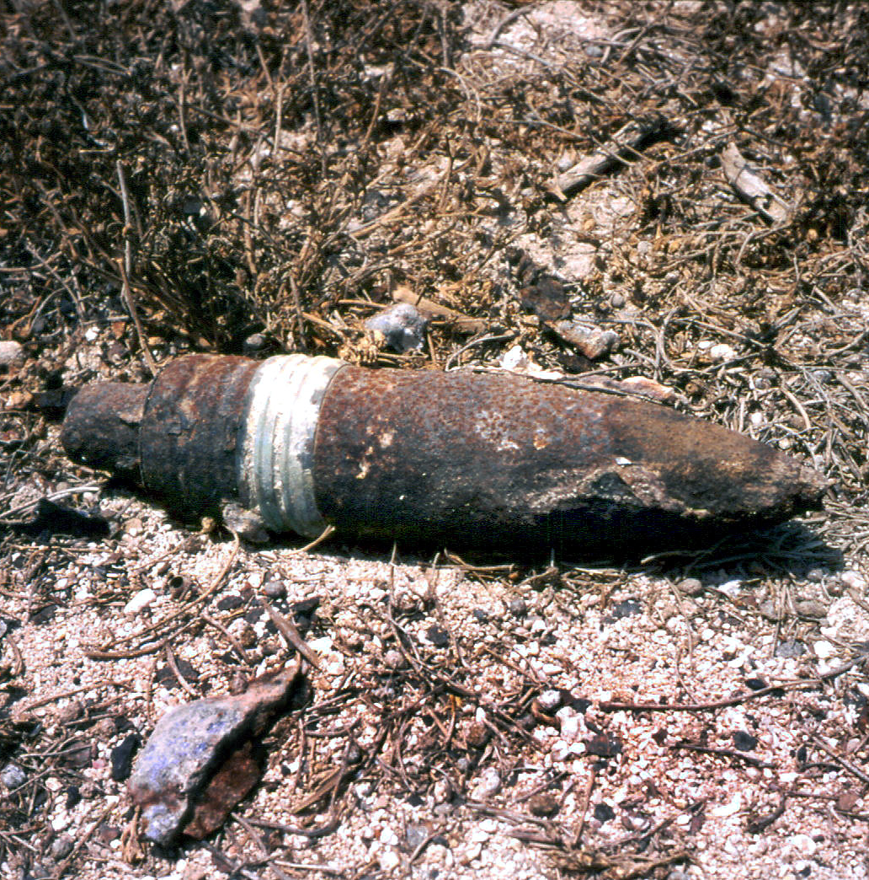
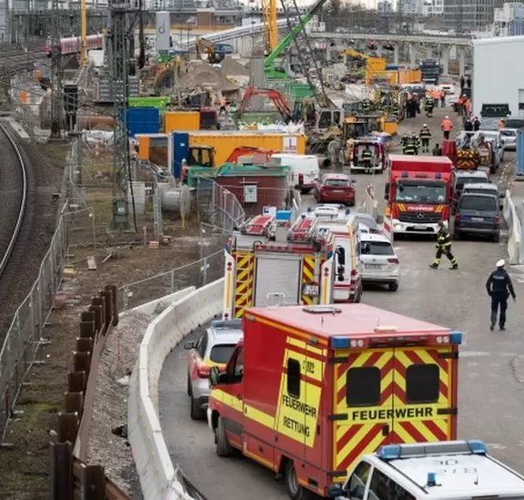
Unexploded ordnance (UXO)
1st december 2021, four construction workers injured from 500lb WWII explosion in Munich (https://www.1stlinedefence.co.uk/news/uxo-related-incidents-in-germany-and-austria-over-the-past-two-decades/)
Notes:
UXOs are bombs that failed to detonate upon impact. To this day, efforts are ongoing to find these bombs and safely dispose of them.

Slide 8
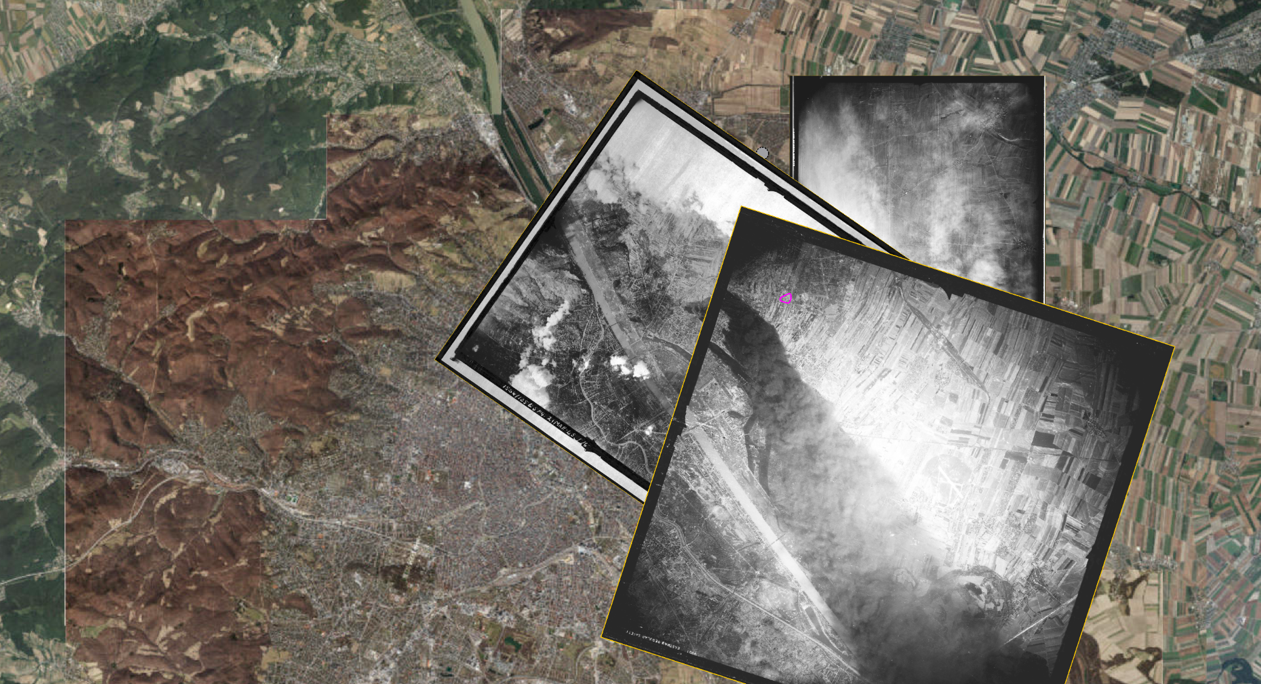
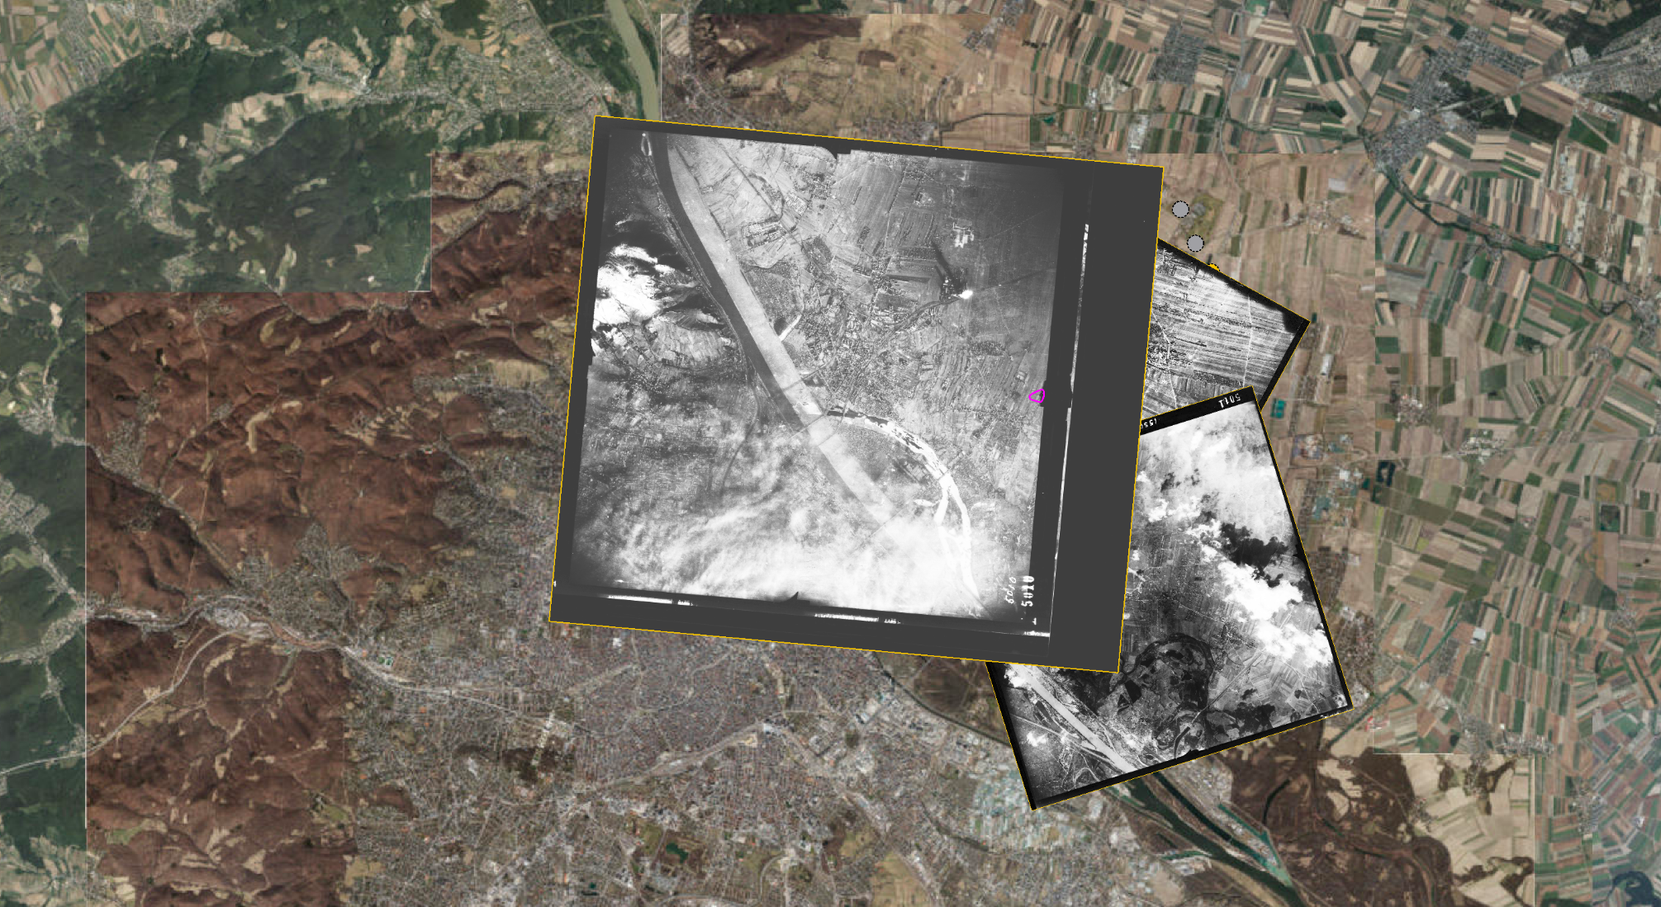
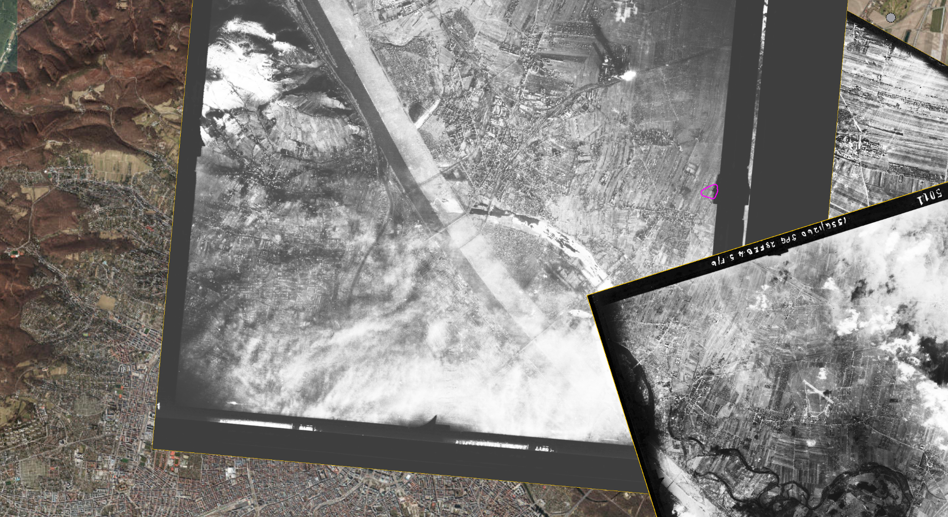
Notes:
An innovative approach to finding these bombs involves aerial photographs that were taken during the aerial bombings by reconnaissance flights, and which are currently stored in English, US and Russian archives. By analyzing these images, experts can pinpoint potential UXOs by reconstructing the damages suffered by an area in time.

Slide 9
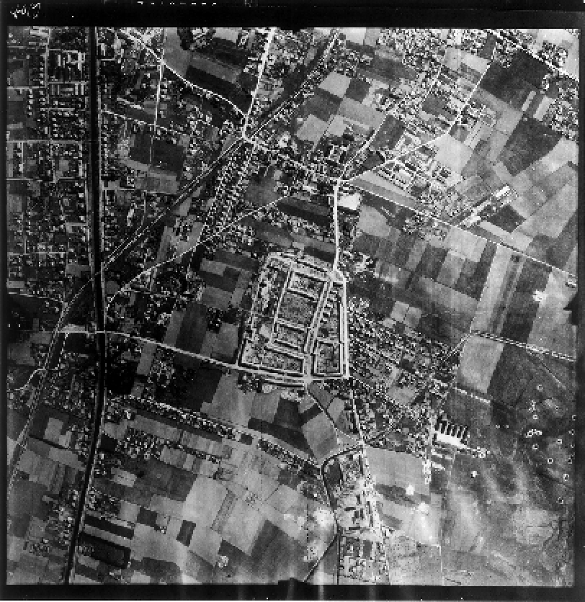
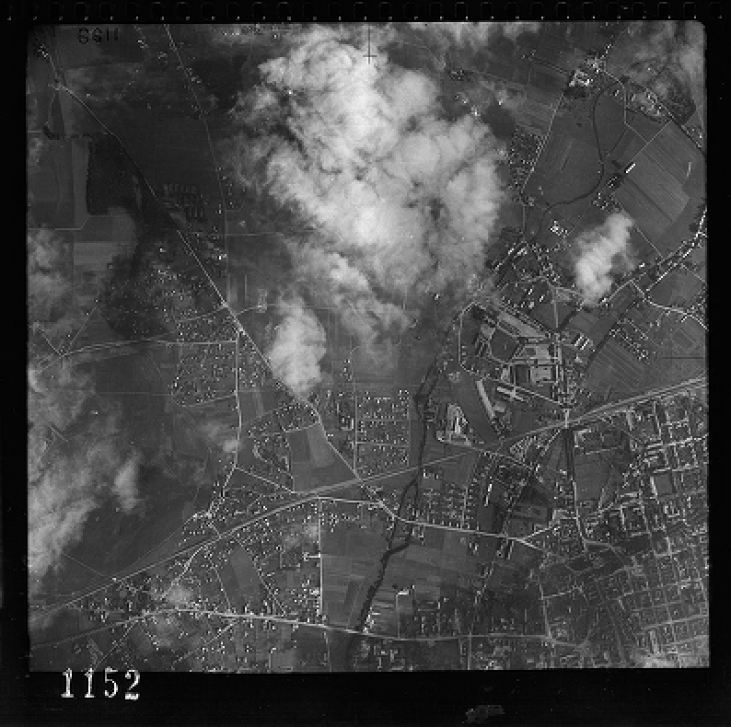
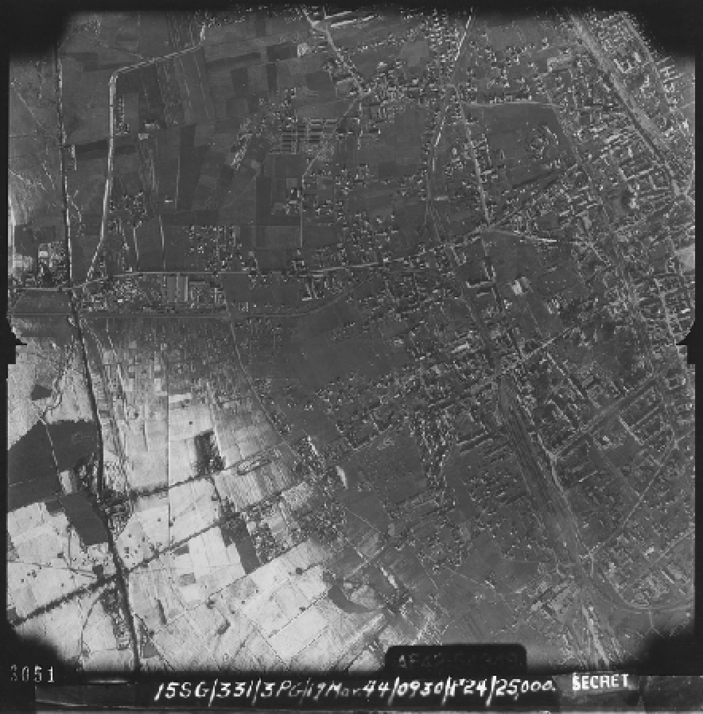
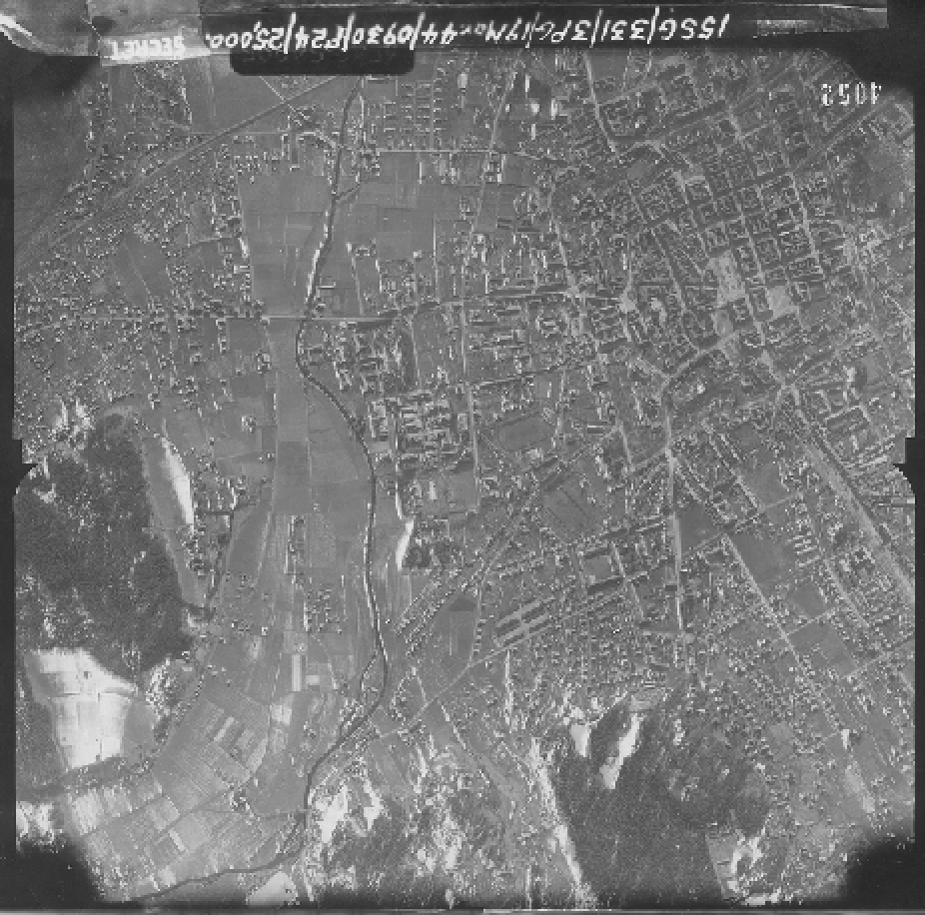
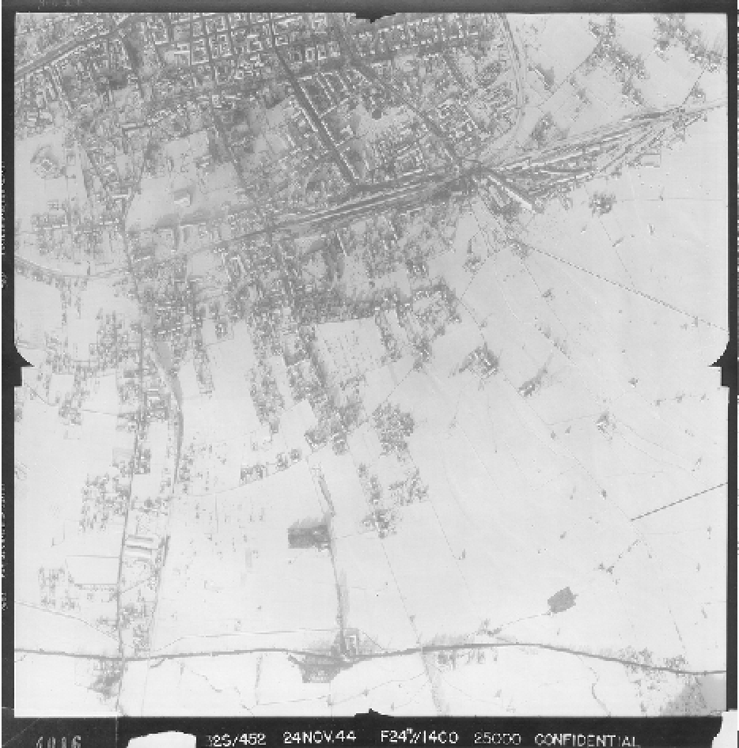
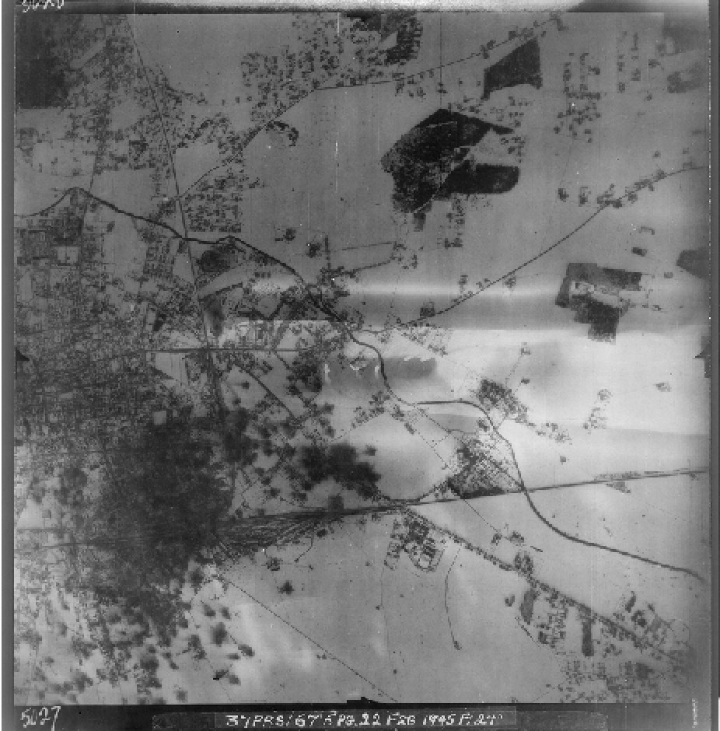
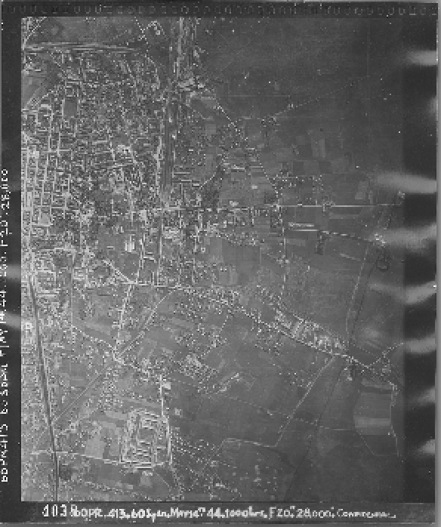
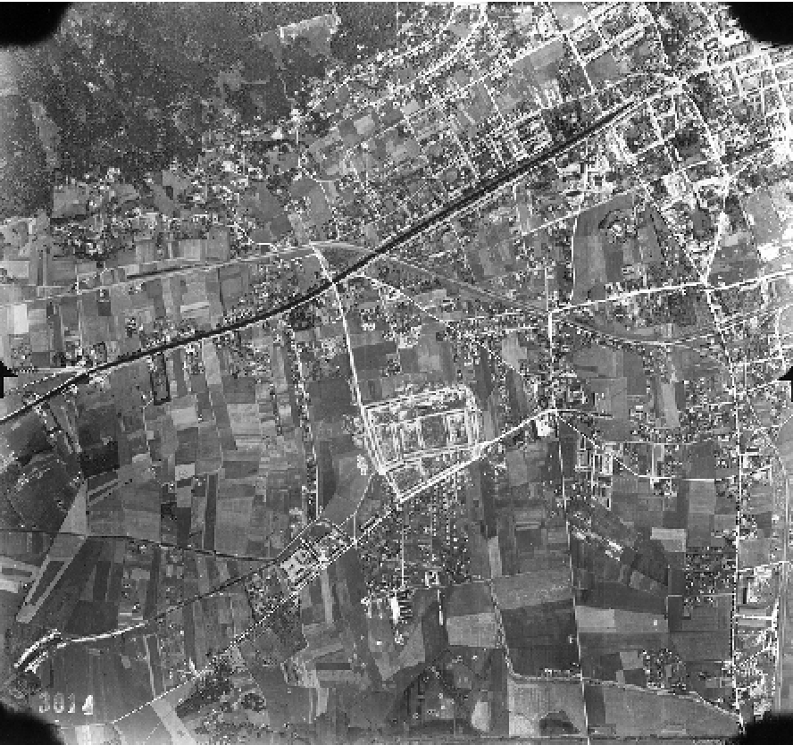
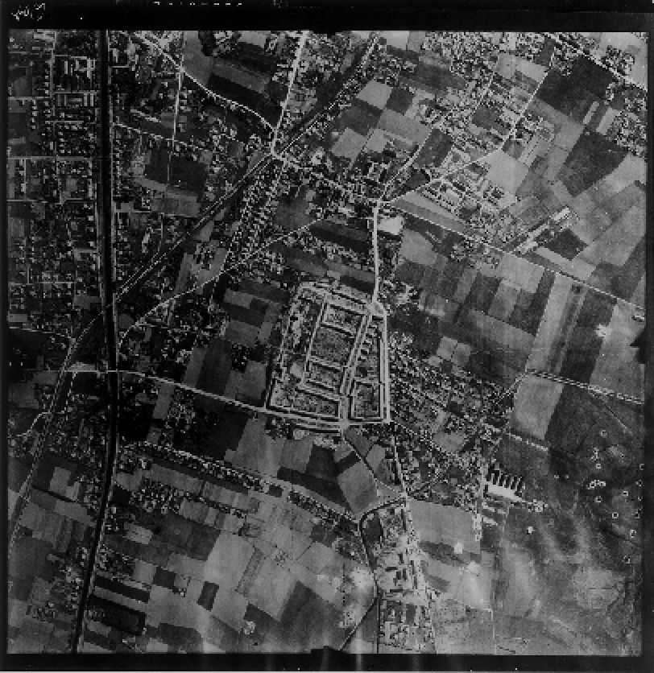
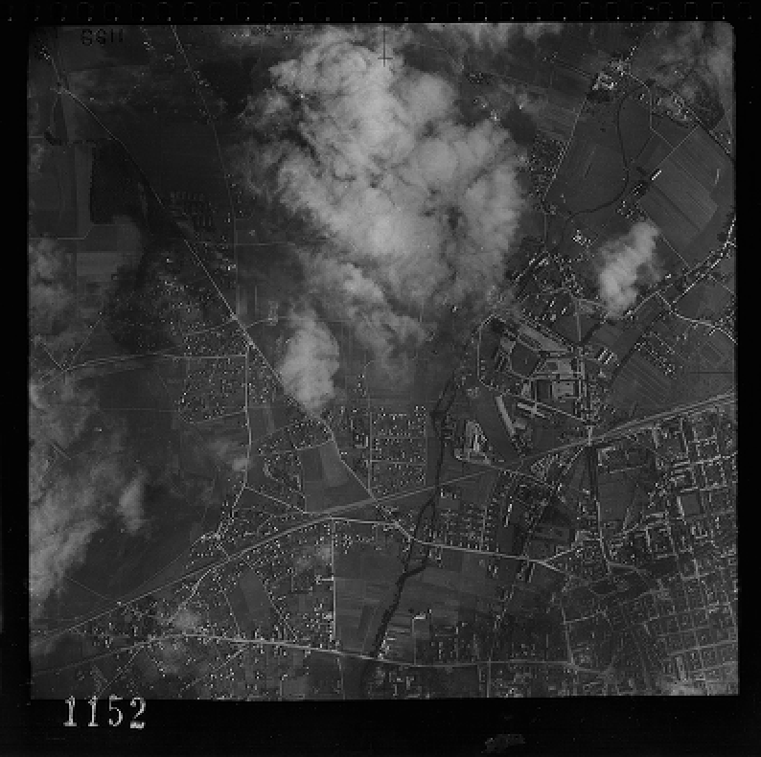
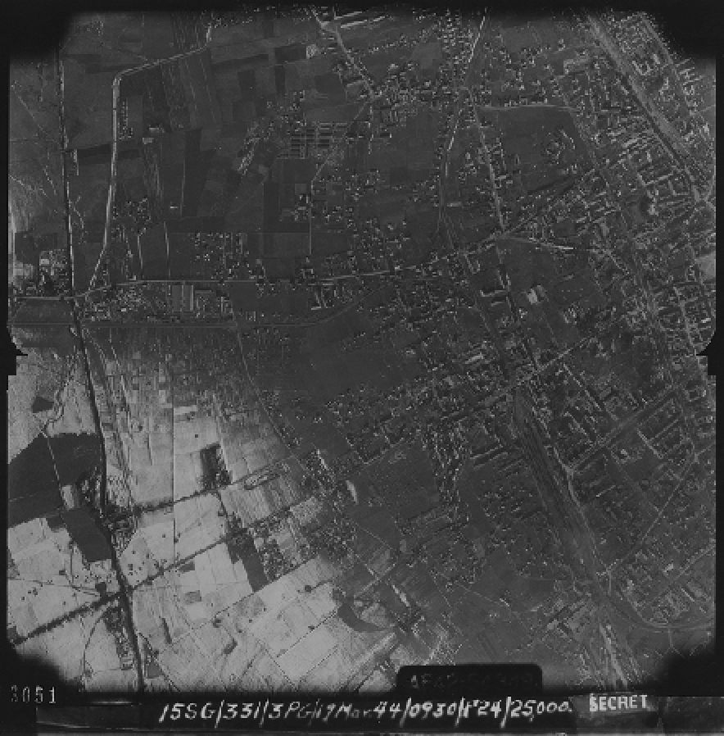
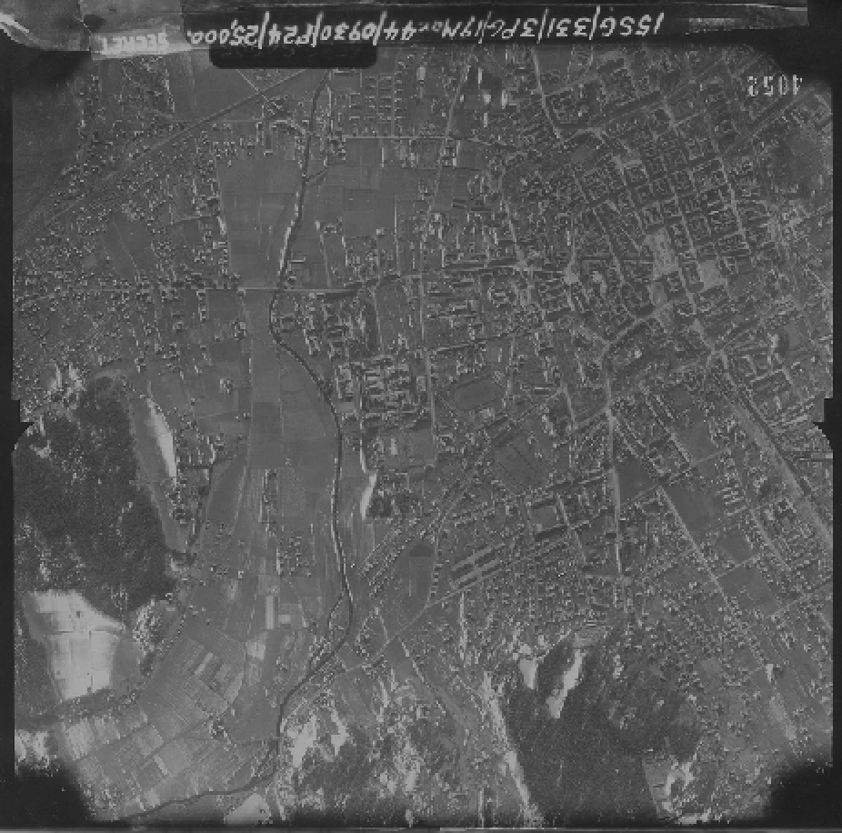
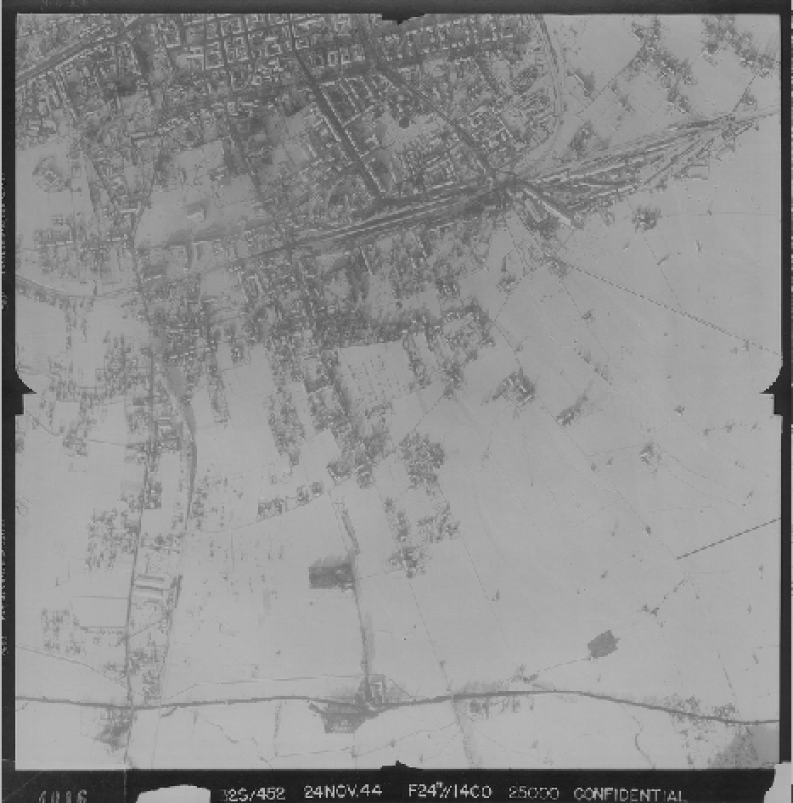
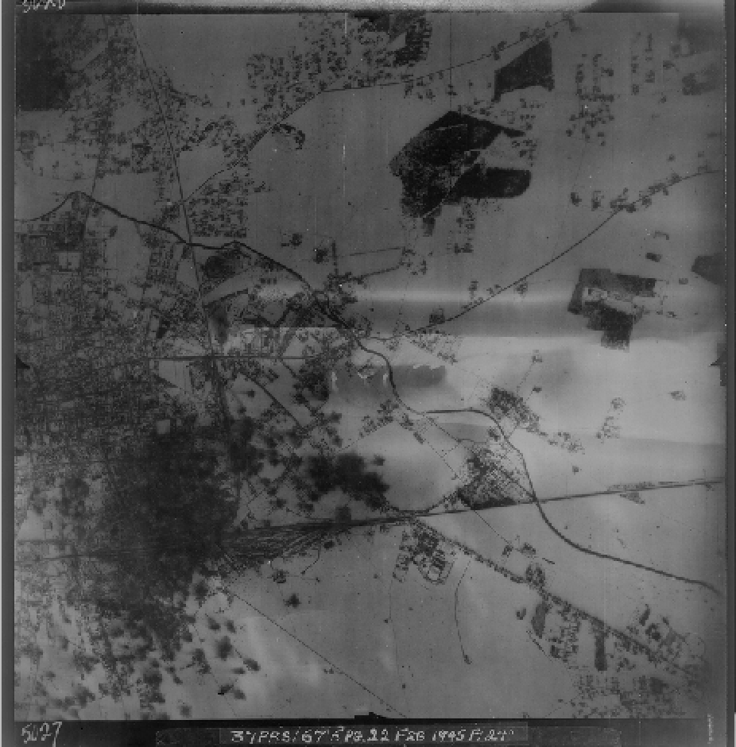
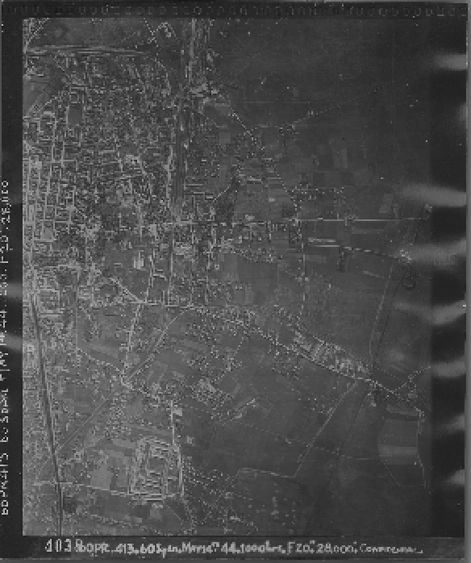
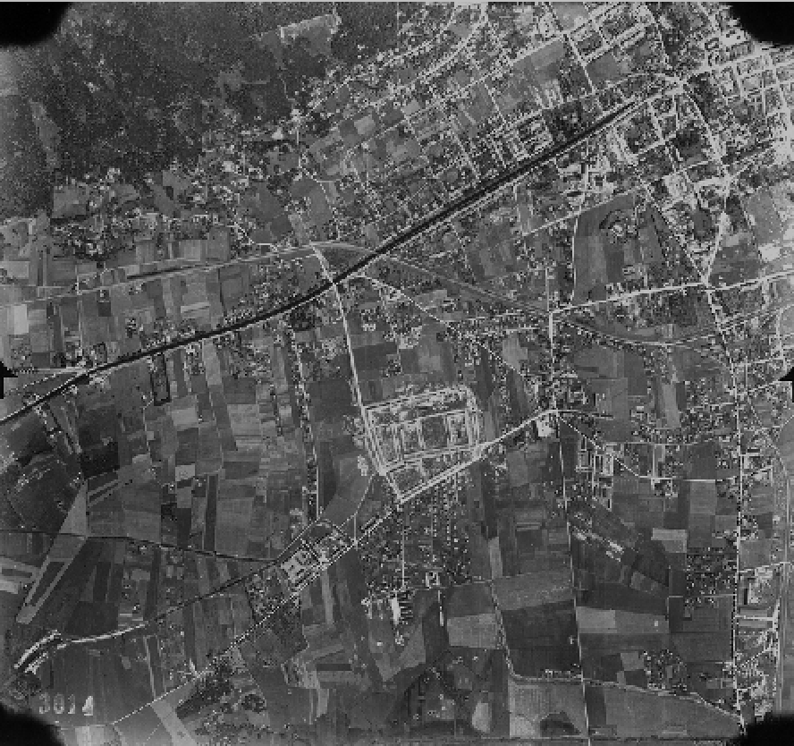
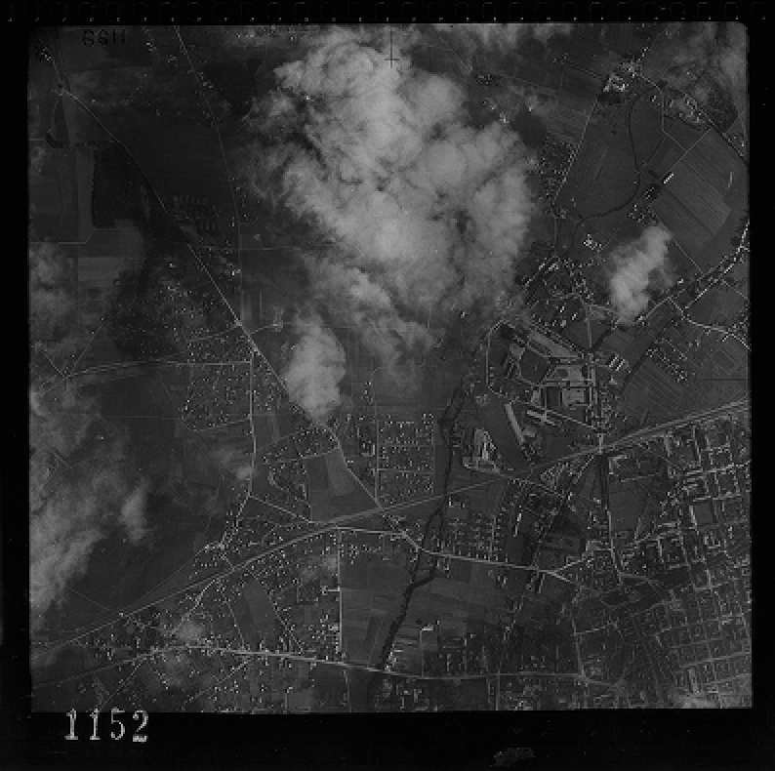
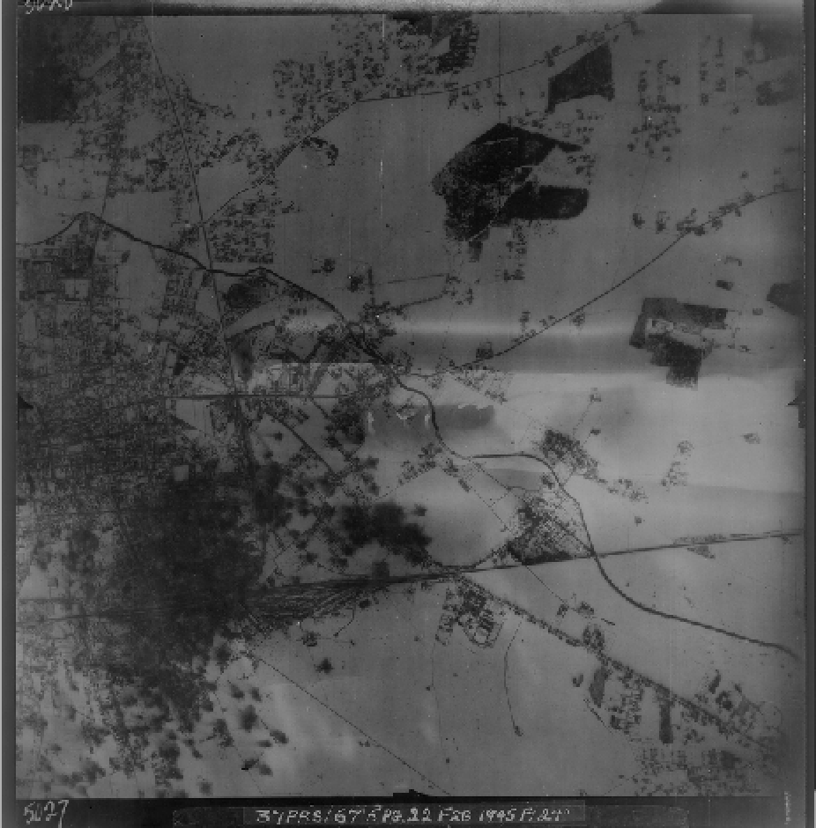
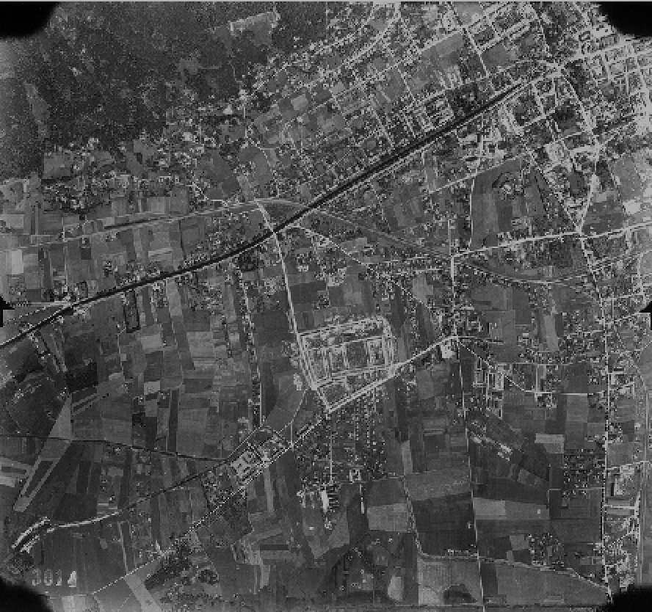
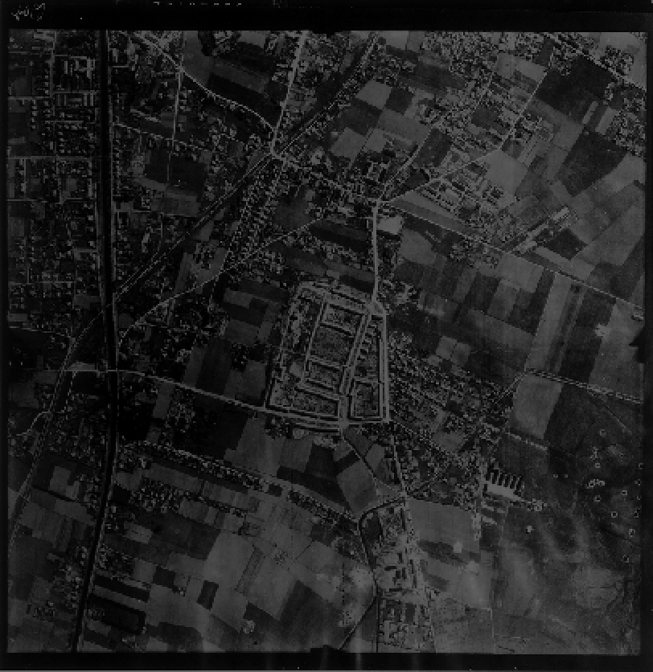
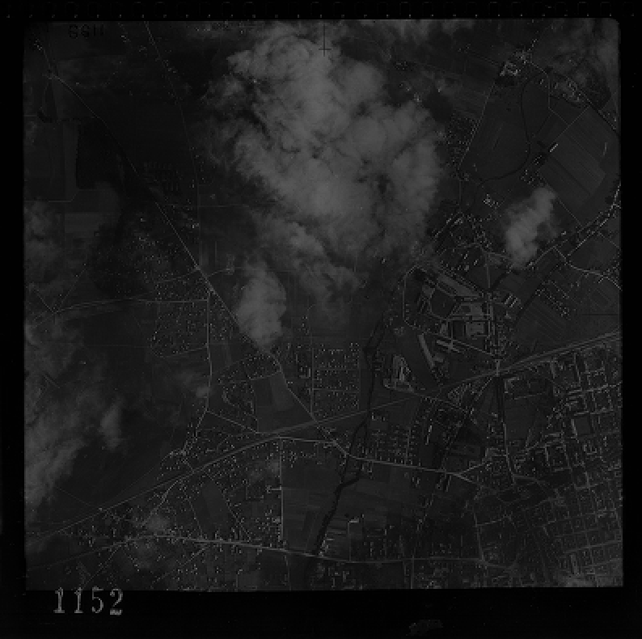
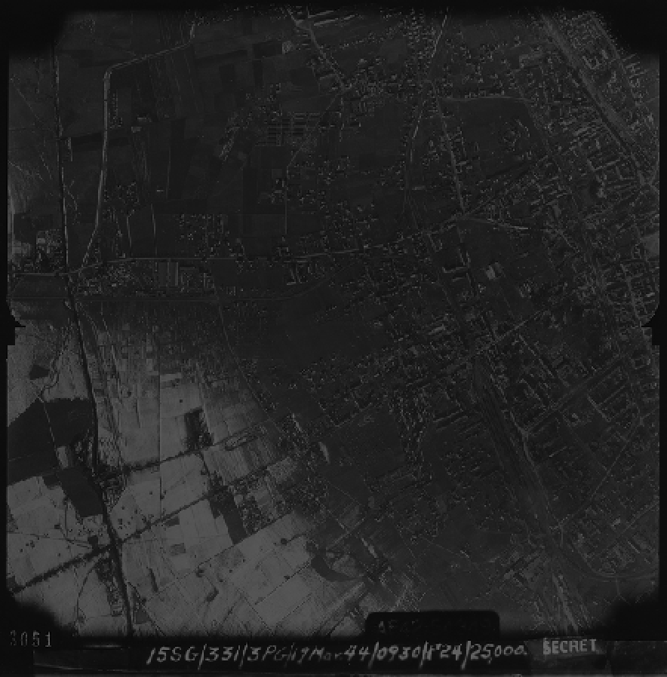
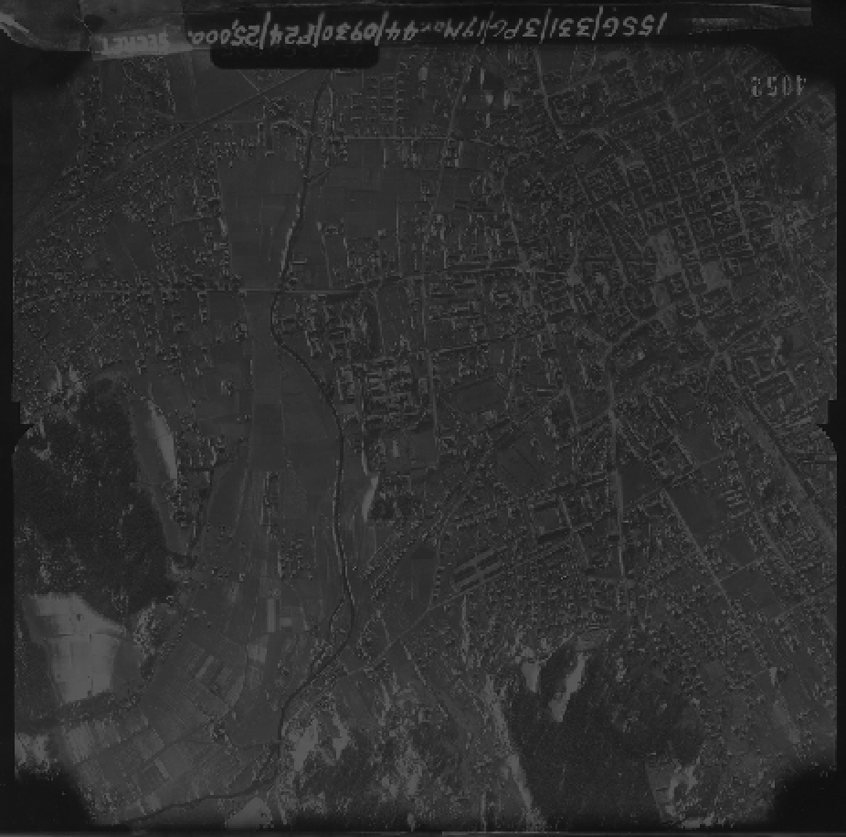
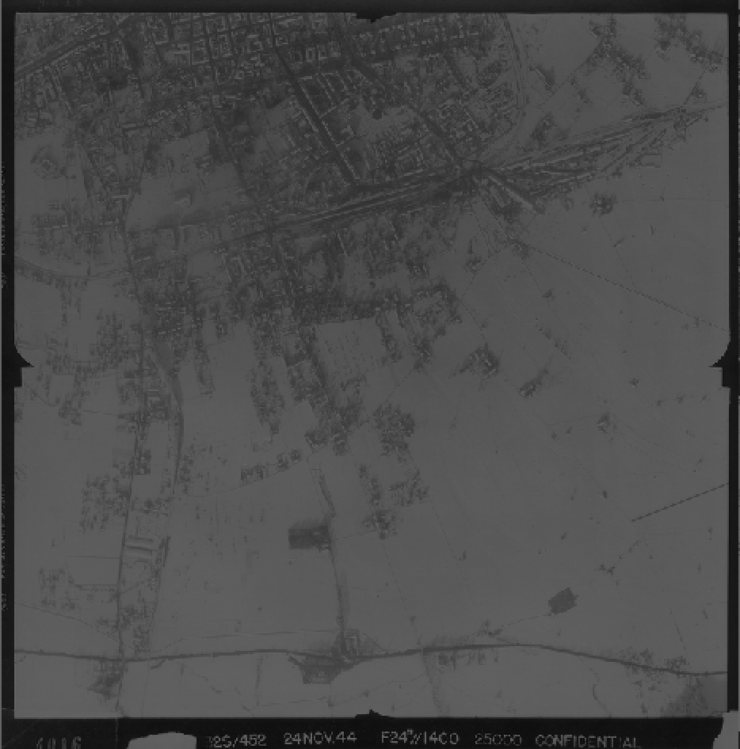
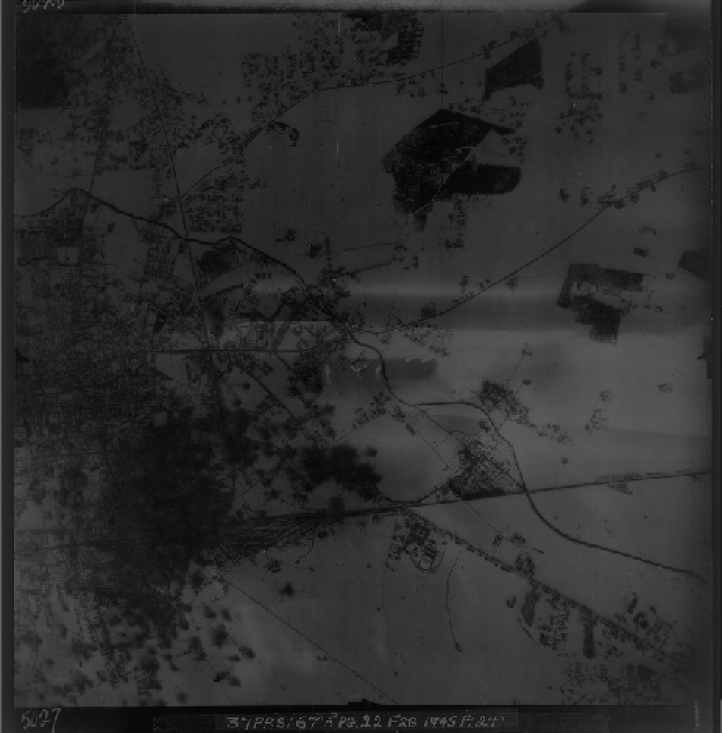
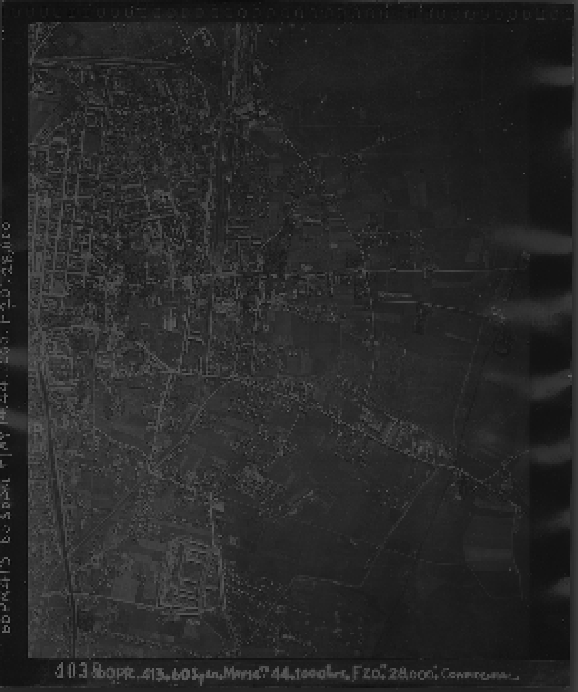
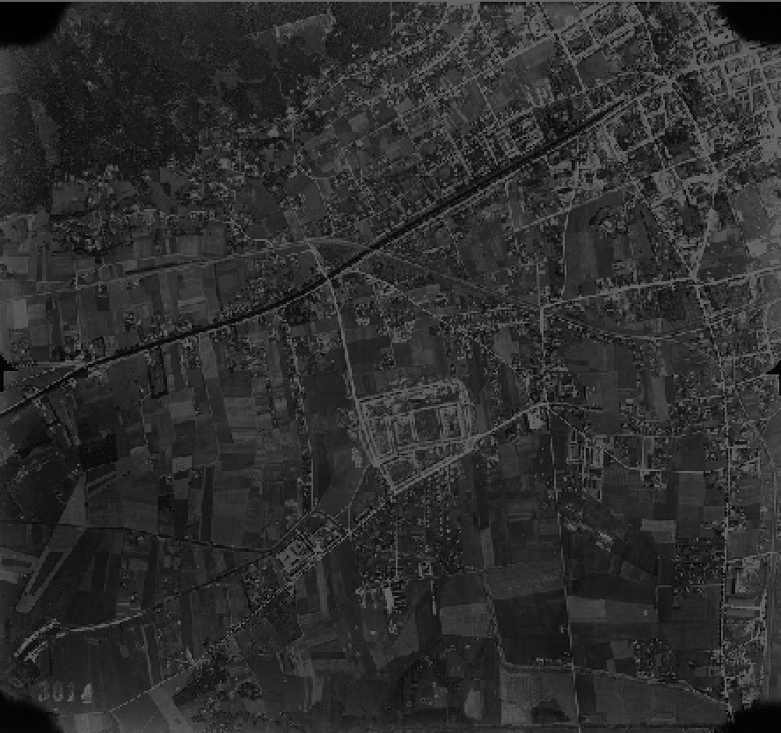
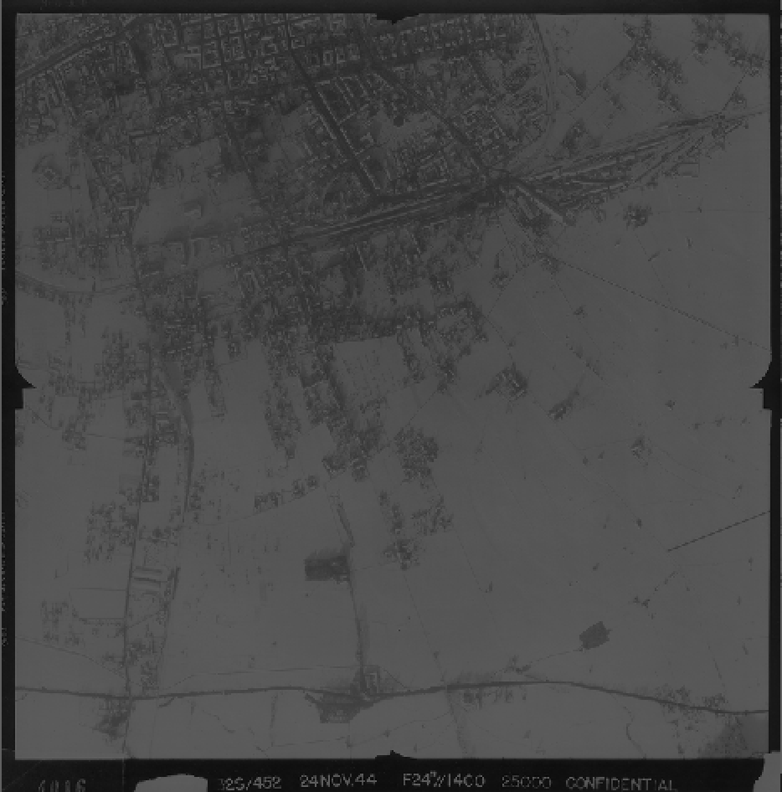
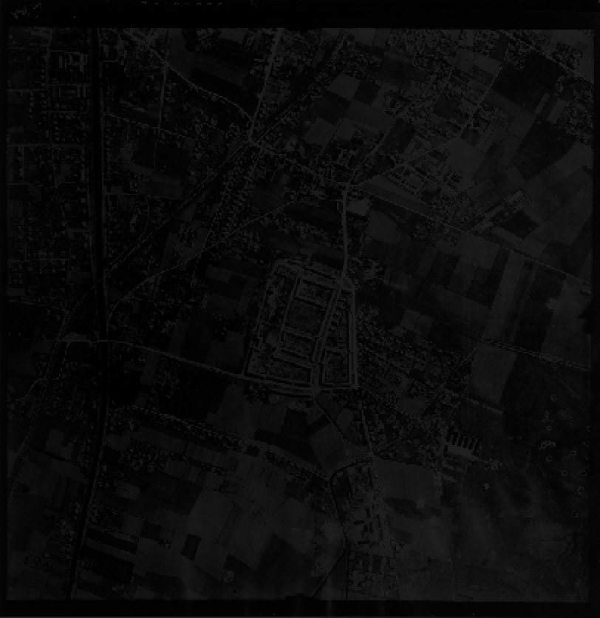
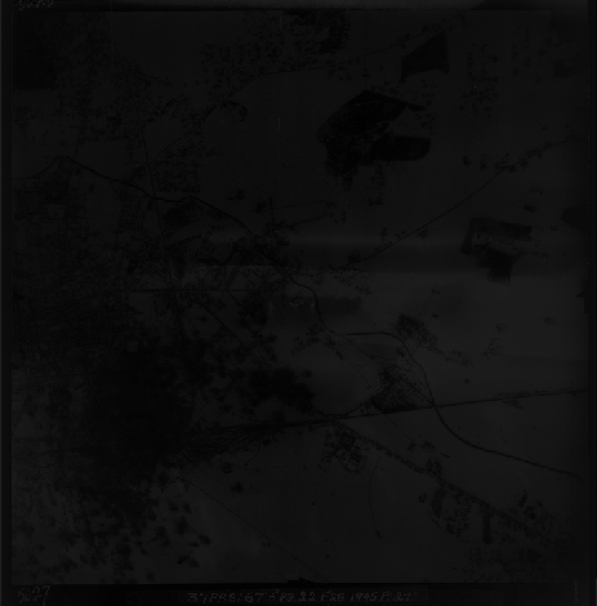
Guided Visual Analytics for
Image Selection in Time and Space
Notes:
However, these images are costly to acquire and analyze, and even for a small area, there are hundreds of them, so analysts are forced to pick an ‘optimal’ set of images. A subset of all aerial images related to an area of interest, we will call a solution to the task. The goal is to have all known aerial bombings in time covered to be sure that there are no missed UXOs, with the minimum and best quality pictures.

Slide 10
UXO Detection from Aerial Images
Notes:
To be clear, Image Selection is only one part of the whole UXO Detection workflow, and the only one we have tackled here from a VA perspective. The actual bomb and crater detection happens later in the process.

Slide 11
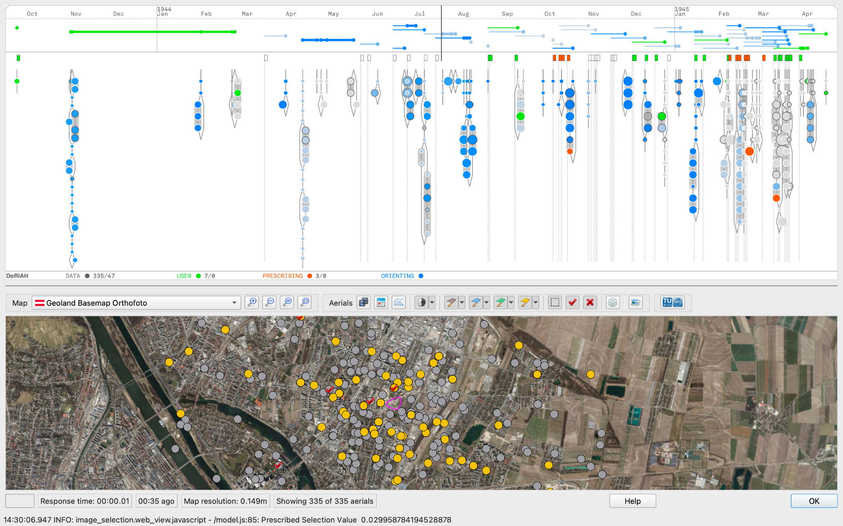
Notes:
We developed an interface for this task with both an abstract and a geographic visualization where images can be inspected and selected.

Slide 12
Visual encoding in time
Images
Flight
Attacks
Timeline
User selection
Notes:
The abstract visualization is a timeline where aerial bombings in tie and available images are put into relation. Everything that is data is in gray-scale. Green represents the selection of the user and its effect on attacks.
Images are circle glyphs which encode important features of their metadata, and they are also encoded in a superglyph when they correspond to the same flight, which also shows some important characteristics of the images (like which camera they were taken with).

Slide 13
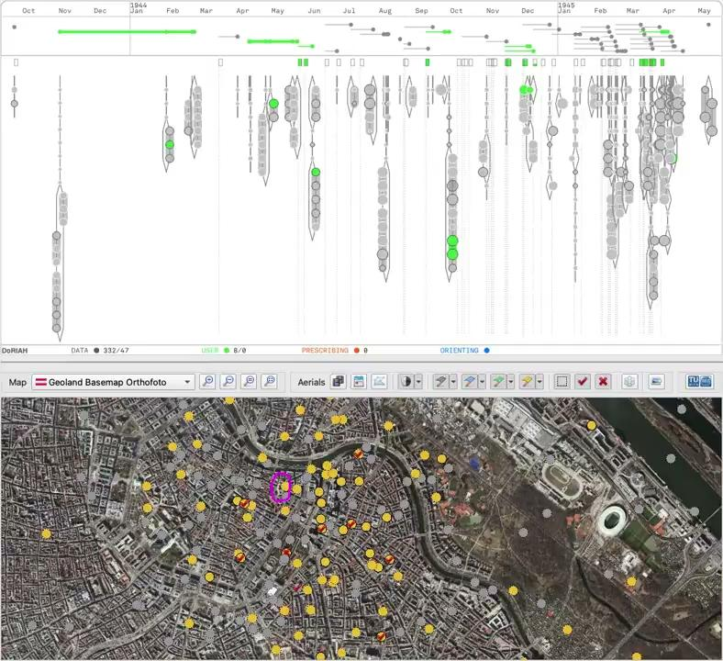
Notes:
This encoding allows to easily filter in time, browse, check the content of an image, select, and verify its covering of attacks. It make the task easier, but can it help make it better?

Slide 14
Guidance design
Two guidance degrees: orienting and prescribing
Each degree is encoded as color layer over the glyphs
Orienting shows individual interest of every image, Prescribing suggest a possible solution image set
ORIENTING
PRESCRIBING
not prescribed
0
interest
1
prescribed
Notes:
So, for that we designed two types of guidance: one that shows the interest of each image individually, based on their metadata, and one that suggest a solution: a selection of images. In guidance terminology, orienting and prescribing guidance. These are encoded in two other color layers: blue and red.

Slide 15
Guidance Model
Notes:
You can see here, how the optimization generates a solution recommendation for the user (in red) while it also highlights in blue what it finds interesting.
The solution provided is not perfect and the user needs to refine it, and that’s because a lot of knowledge and constraints for each scenario are only in the domain expert’s mind, what they call, the historical interpretation. Also on the quality of the images, which we won’t evaluate automatically.

Slide 16
Evaluation Methodology
2 other experts
unguided
guided
Ranking
6 domain experts
Two real-world scenarios
Indexes
Notes:
To test our guided prototype we recruited 6 domain experts from Luftbild Datenbank, our partner company, and gave them each two real world scenarios to perform image selection. 20 minutes each, first with the unguided system and then with the guided system. Then, we analyzed their selection data in two ways.

Slide 17
Partial Indexes
Six indexes, each capturing a partial aspect of the quality of a solution that is valued by domain experts.
Notes:
For our guidance model we had created at first several indexes that measured different aspects that mattered for the quality of a solution. For example, the TIME COVERAGE INDEX measures how much time in total the selected images cover; or the BEST SHOT INDEX attributes a score to each attack according to the best image that covers it.

Slide 18
Indexes
Participants
Change with guidance
Positive
Negative
Notes:
When analyzing the participant selections’ partial indexes, we could observe an overall improvement when using the guided system. The lines shown in these graphs for each participant’s is the difference between the measured index for task 1 and task 2, green if there was an improvement with guidance.

Slide 19
Indexes
Participants
Change with guidance
GUIDANCE SOLUTION’S OVERALL INDEX
Positive
Negative
Notes:
We can see here 5 out of 6 participants did equal or worse than the guidance model in the first task, and BESTED the guidance model when guidance was provided.

Slide 20
Indexes
Participants
Change with guidance
Positive
Negative
Notes:
The overall index, is the average of all other partial indexes.
For example, a couple of participants significantly improved their time coverage, and most of the participants reached a 100% best shot index when provided guidance.

Slide 21
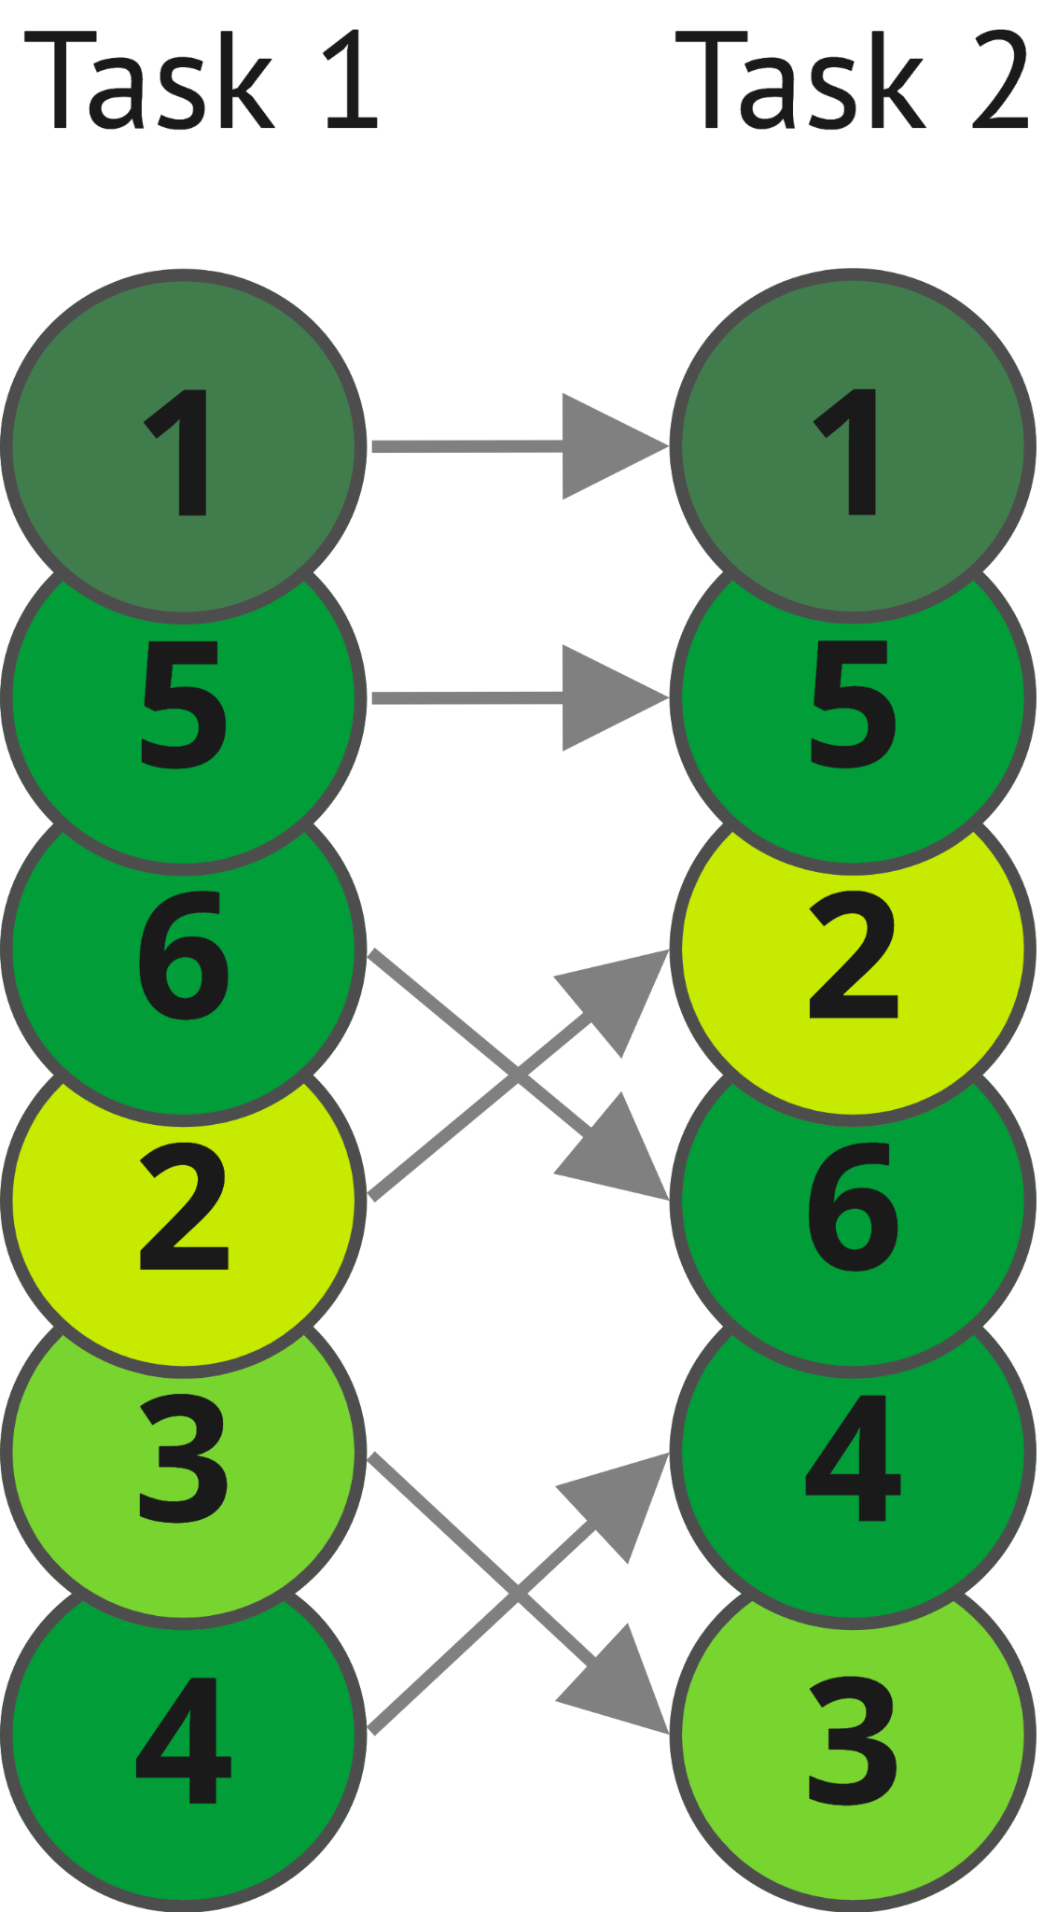
Expert ranking
The ranking of the solutions by experts is different from the ranking generated by the indexes
Participants 1 and 5 dominate both tasks due to their experience and domain knowledge
Guidance may improve certain metrics but is not a replacement for knowledge in this case
PARTICIPANTS
PARTICIPANTS
Notes:
So, there is a hint that guidance can generally help users improve objectives in their optimization. But we also asked our two other domain expert’s to rank the participant’s solutions according to their criteria. And for both tasks, they consistently ranked the most experienced participants as the best solutions. Result which was not totally reflected by our partial indexes.

Slide 22
Methodology
Expert criteria
unguided
guided
Ranking
6 domain experts
Two real-world scenarios
Indexes
Model equations
Notes:
This difference propelled to reformulate our model of the problem, but that part of the story you will find in the paper.

Slide 23
In conclusion
We tackled a wicked optimization problem from a guided VA perspective in the domain-specific context of UXO detection
We developed a system for the task of image selection in time and space and tested it with domain experts in guided and unguided scenarios
We found evidence of improved performance with guidance, even under imperfect guidance
Notes:
[READ SLIDE]
…Specifically, we found a tendency of guidance to improve partial metrics.

Slide 24
Outcomes
The VA system and the guidance were positively received by experts working in the field
They praised the visualization schema and the orienting guidance
After the analysis of the study results we were able to improve our guidance model
Notes:
Our approach was positively received, praised for its simplicity and the guidance.

Slide 25
Novelties
First domain characterization of UXO detection with aerial imagery
First VA approach to image selection for UXO detection
First attempt at modelling image selection from expert knowledge
Notes:
There are also several novelties in this work, as this is the first paper to tackle image selection from a VA approach.

Slide 26
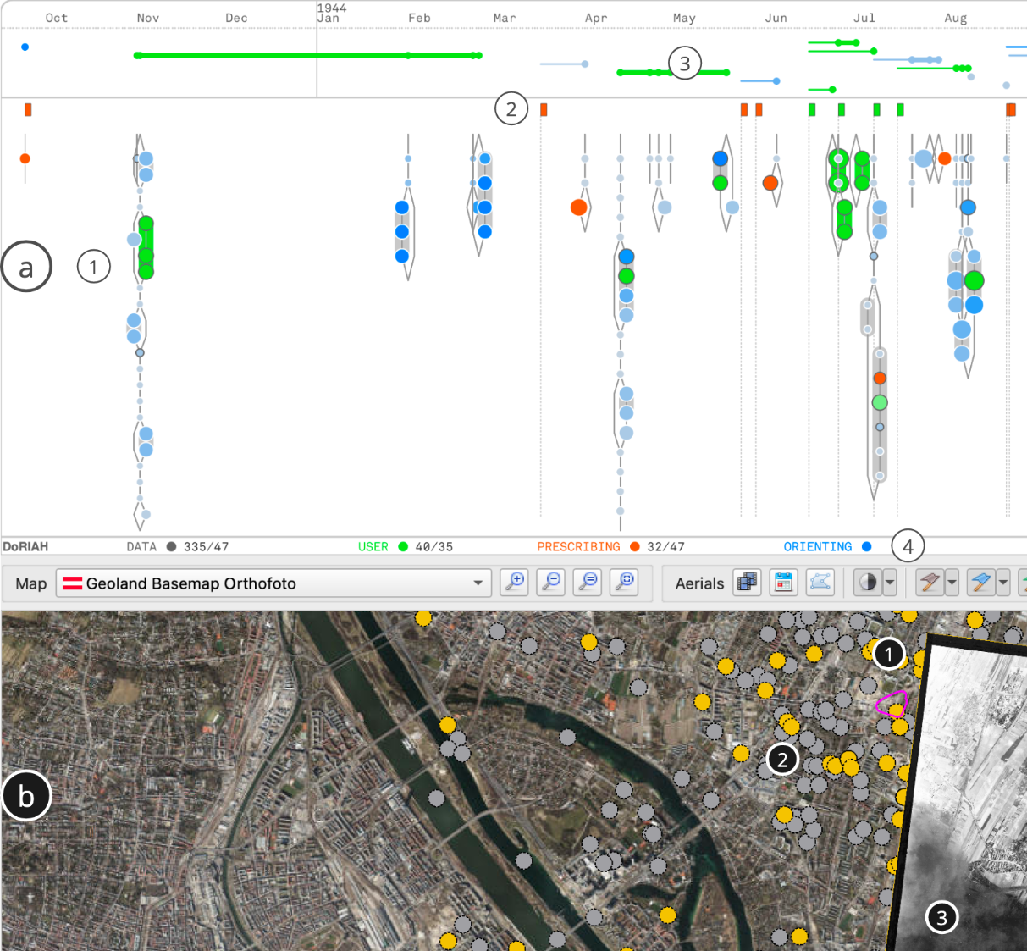
Guided Visual Analytics for Image Selection in Time and Space
Ignacio Pérez-Messina
Davide Ceneda
Silvia Miksch
Notes:
Thank you for your attention and I’m happy to answer any question

Slide 27
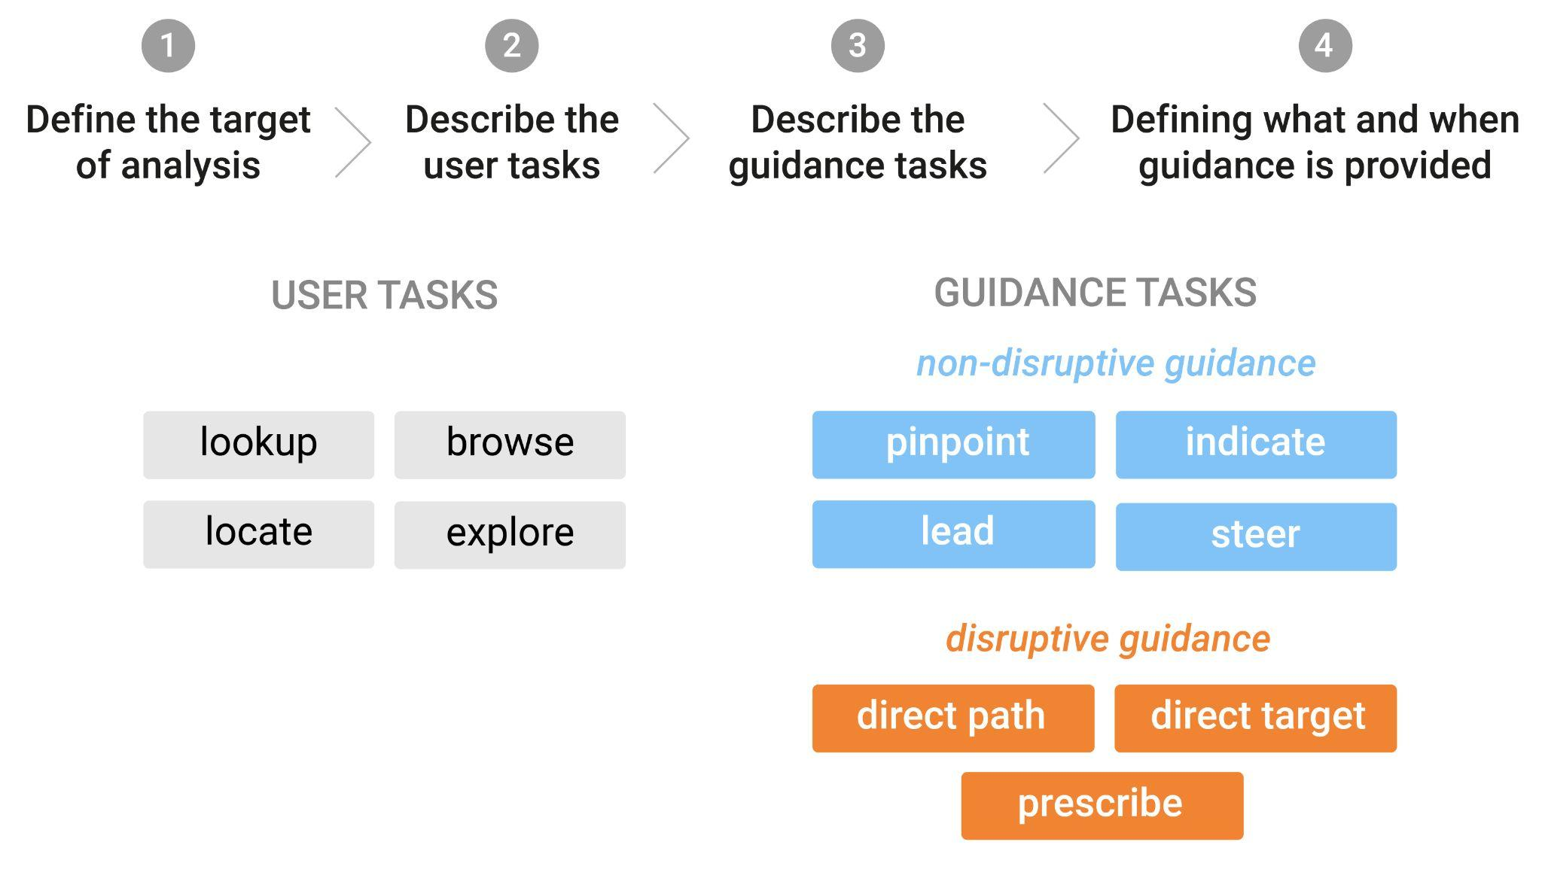
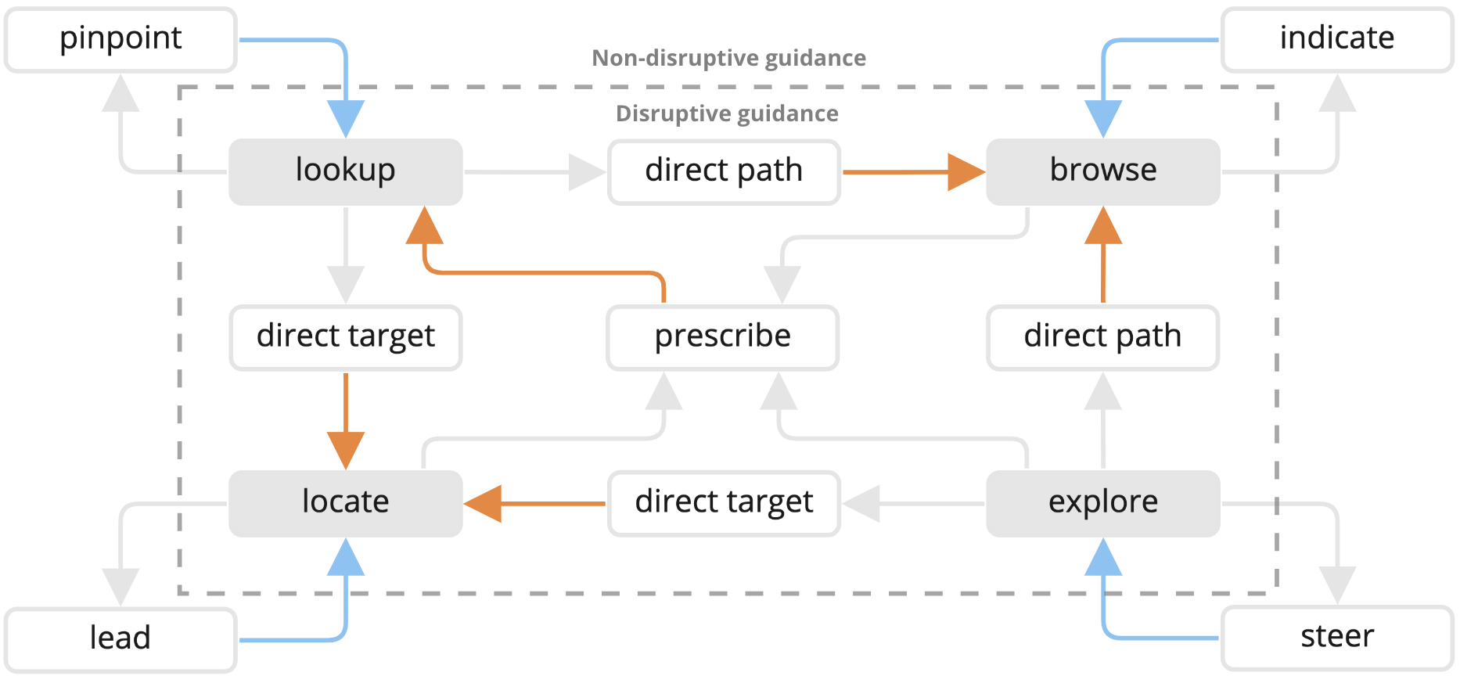
Novelties
Pérez-Messina, I., Ceneda, D., & Miksch, S. (2023). A Methodology for Task-Driven Guidance Design. EuroVA 2023.
Pérez-Messina, I., Ceneda, D., El-Assady, M., Miksch, S., & Sperrle, F. (2022, June). A Typology of Guidance Tasks in Mixed-Initiative Visual Analytics Environments. In Computer Graphics Forum (Vol. 41, No. 3, pp. 465-476).
Notes:
First application of the task-driven methodology for guidance designwhich is based on the typology of system guidance tasks

Slide 28
The Cake

Slide 29
Task Analysis for Image Selection
Legend
Notes:
To tackle the design of an interface for the task image selection, we decomposed the process into an iterative loop of subtasks, based on Brehmer and Munzner’s multilevel visualization task typology. Each iteration culminates with the addition or removal of an image from the selection. This task analysis only concerns the user tasks with the visualization.

Slide 30
Task Analysis for Image Selection
Legend
Notes:
But we did not only want to provide experts with an interactive data visualization, but also with guidance through the analysis. Thus, we added two different guidance tasks to our task design, that support two different user tasks in the workflow. I am going to talk a bit about guidance now.

Slide 31
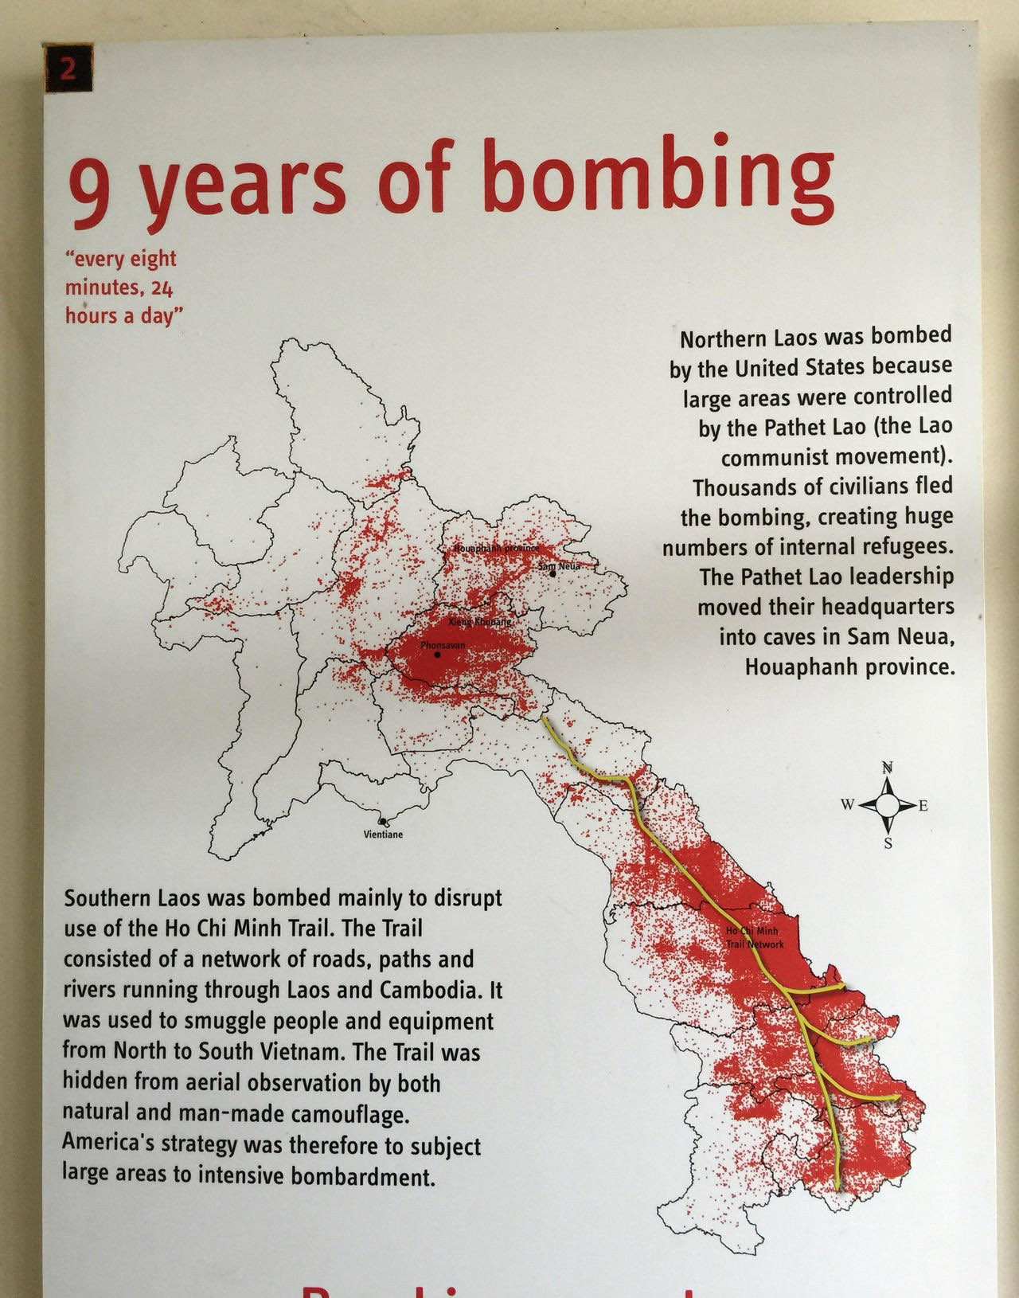

Slide 32
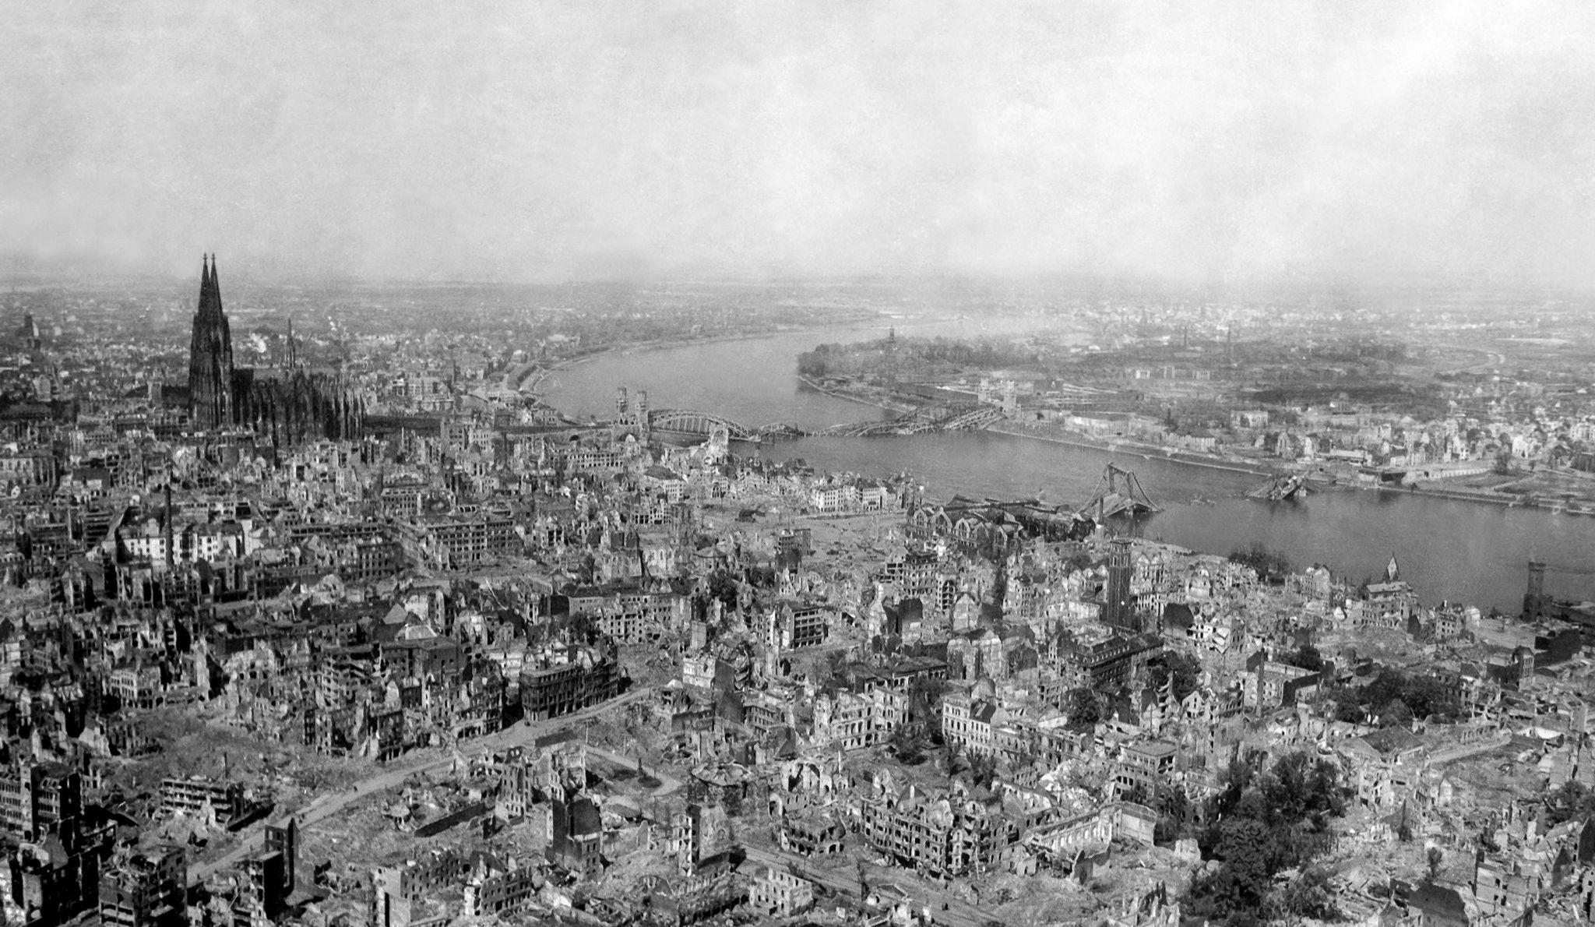
Notes:
During the devastating chapter in history, both Axis and Allied forces employed extensive aerial bombardment campaigns

Slide 33
Notes:
The result is a guidance model that iteratively observes and selects images until reaching a full solution, taking into consideration the current selection of the user and its changes. Here it looks a bit crowded but [make a video with flight isospacing]

Slide 34
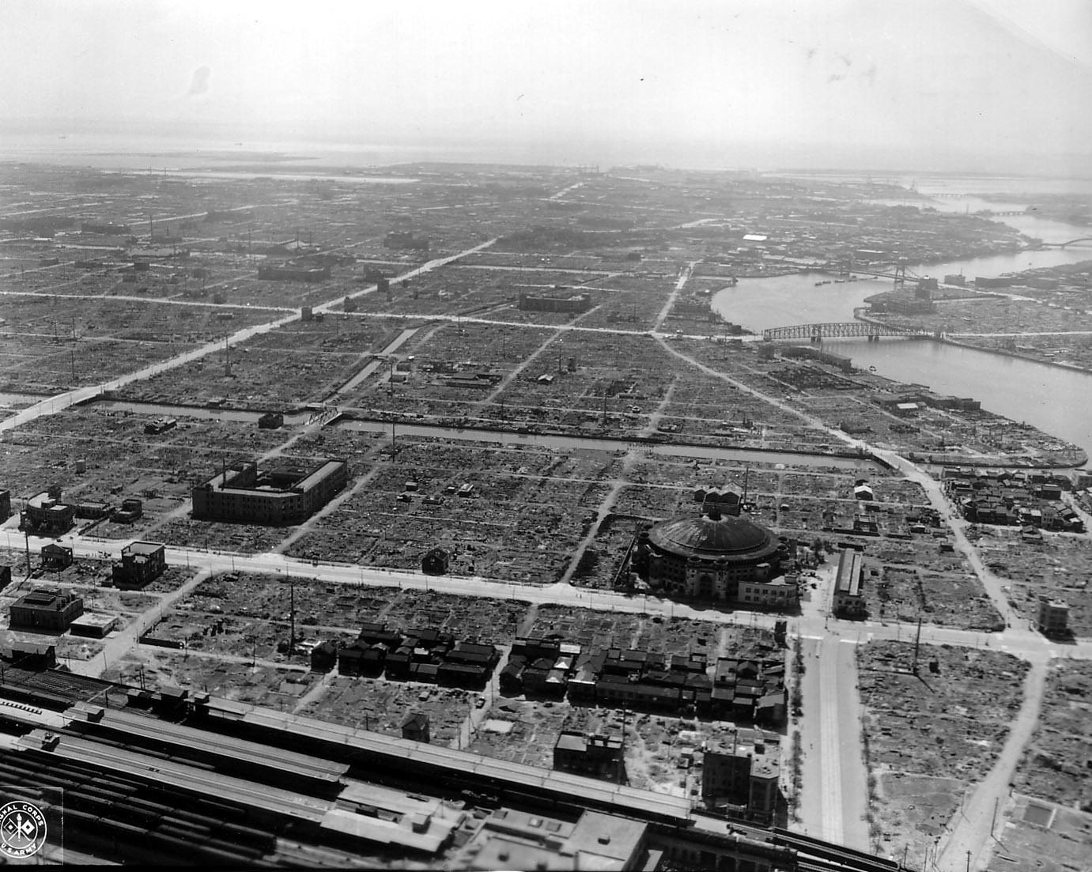
Notes:
These bombings left a lasting impact, particularly in the form of unexploded ordnances (UXOs)

Slide 35
Image Selection for UXO Detection
Notes:
In image selection for UXO detection, the 'subject' is a large geographical area and the 'changes' are the aftermath of aerial bombings during wartime.

Slide 36
3D subject
time
Images
of the subject
Notes:
In image selection, the goal is to cost-effectively reconstruct all changes of an area of interest in time using only images.

Slide 37
3D subject
time
Images
of the subject
Notes:
Given that each image comes with associated costs, a minimal, yet comprehensive set must be selected from the available collection.

Slide 38
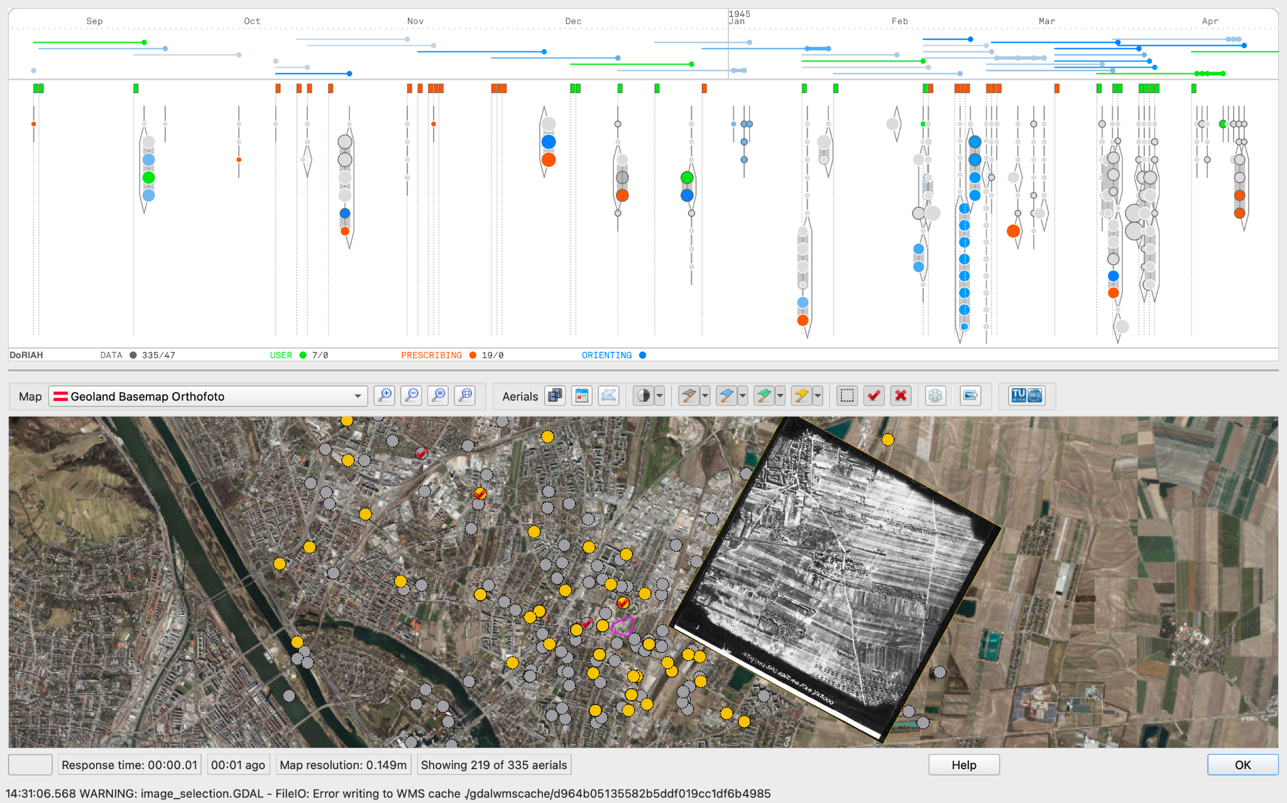
Notes:
The system also comprises a geographical view were the images are displayed and can be scrutinized, manipulated and georeferenced

Slide 39
Evaluation of study results
Our partner experts ranked the user-generated solutions
This revealed that some metrics were much more important than others
It also showed there were conflicting criteria between experts but a general agreement
Notes:
However, when asking the our partner experts to rank the user study solutions themselves, we found that most indexes from the exploratory model did not have an impact on the quality of the solution.

Slide 40
Indexes
Notes:
When we saw what the participants did in the task -based user study through the indexes, we could observe a general improvement when using the guided system, represented by the green bars for each participant.

Slide 41
Expert ranking vs. Overall Index
≠
Notes:
However, the change in the rankings that the overall index observe between tasks, did not correlate so well with the experts’ assessment of the participant selections over the two tasks. For example, and as you cansee, for the experts, participants 1 n 5 had for both tasks, the best solution, while according to the overall ranking, 5 scored much worse in the first task. This meant that not every index mattered equally and none of them sufficed by itself to predict quality according to expert standards.

Slide 42
Analysis of expert quality criteria
Notes:
So, we had our partner experts explain us their rankings in great detail, and so we could arrive at a rule-based formulation of what is a quality solution.

Slide 43
Solution Quality Model
Notes:
Based on some on the time coverage index and the bestshot index, the ones that revealed more important, and the rules we derived from the expert rankings, we finally arrives at a measure of quality that could predict the quality of solutions according to our expert ranking.

Slide 44
Guidance Model
Quality of the solution
Solves a multi objective combinatorial optimization problem
Approximates a solution via a greedy heuristic
The model evaluates the improvement of a solution by adding/removing an image from the selection and takes the most significant decision
resilience of the solution
efficiency of the solution
Notes:
With this, we could formalize our optimization problem and create a model that generates better solutions and adapts to the user’s intention. The guidance algorithm evaluates the value of adding a each image to the selection in each iteration and picks one at a time, and so it tries to approximate to the Pareto front of economic yet resilient solutions.

Slide 45
Subjective Results
Visualization
Guidance
Notes:
Of course, we also ran a survey on qualitative aspects of the visualization and the guidance to confirm expert participants approved the system. Details on the paper.

Slide 46
Conclusion
Notes:
To conclude,

Slide 47
resilience of the solution
efficiency of the solution
Notes:
The problem we tackle in this paper is that of guided interfaces for optimization problems. Wicked optimization problems are better tackled by interactive VA interfaces, but not always direct model manipulation is the answer, but mixed-initiative features.

Slide 48
Guidance
Notes:
Here we investigate a certain kind of mixed-initiative theory: guidance.

Slide 49
Notes:
For this particular task of image selection in time and space, we have created a custom embedded glyph visualization, where two color encodings represent each one kind of guidance

Slide 50
Notes:
The guidance-enhanced glyphs are placed into a timeline and a coordinated map view that allows exploration of the elements in time and space.

Slide 51
UXO Detection
Notes:
What images are we talking about? The context is UXO Detection from aerial images.

Slide 52
Agenda
Introduction
VA System
Guidance
User Study
Conclusion
Notes:
In this presentation, I am just going to talk about the VA system we have created, the guidance and our user study. Many other things as task analysis and domain characterization, you can find in the paper.

Slide 53
Visualization of Aerial Images in Time and Space
Notes:
We have designed and implemented a visualization to aid expert analysts in the task of image selection for UXO detection.

Slide 54
Unguided
With guidance
Notes:
(The two types of guidance are shown in two different color layers: the blue layer is orienting guidance, and the red layer is prescribing guidance. Red image glyphs are the guide’s selection, while in a continuous range of blue, the user is indicated what images the model finds more interesting from the whole dataset.)

Slide 55
User study
Notes:
For the evaluation

Slide 56
Interactive optimization
HUMAN EXPERT
SOLUTION SPACE
EXPERT SYSTEM
Notes:
In this paper, we tackle an interactive optimization problem from the perspective of guided visual analytics. In interactive optimization, an of course very big solution space is somehow explored by both the user and an optimization model. This is necessary, as real-world problems usually require a human-in-the-loop, as fully-automated solutions are deemed incomplete or unethical. The question here is, how do user and system collaborate together?

Slide 57
Indexes
Notes:
However, some users let themselves be more influenced by guidance than others, and we observed also that most expert users weren’t in need of guidance to perform the task, even in a new interface.
We could also measure how much guidance was followed or implicitly rejected by users, by comparing how much of guidance pick was on the selection on the first task vs. the second task. Probably shouldn’t say this. They said that orienting guidance literally gave them something to see.

Slide 58
Guidance
MIXED-INITIATIVE VA
The active process addressing “knowledge gaps” of the users that hinder their analytical progress by identifying them and providing orienting, directing, and prescribing guidance.
INTENTIONS
SUGGESTIONS
HUMAN EXPERT
EXPERT SYSTEM
Pérez-Messina, I., Ceneda, D., El-Assady, M., Miksch, S., & Sperrle, F. (2022, June). A Typology of Guidance Tasks in Mixed-Initiative Visual Analytics Environments. In Computer Graphics Forum (Vol. 41, No. 3, pp. 465-476).
ACTIONS
EXPLANATIONS
Notes:
We call this the problem of guidance. Guidance is the active support of the user in overcoming knowledge gaps that may hinder their analytical progress, such as, not knowing what is the best solution to a problem or how to improve an existing one. Mixed-initiative approaches, represented here like a dialogue between user and system, employ guidance to communicate system recommendations to the user.

